Slide 1
PPOL 105: Programing & Data Analysis for Public Policy
Notes:
“Introduces students to key programming skills in Excel and R for data management, data visualization, and descriptive statistical analysis for policy making.“

Slide 2
Week 1: Introduction

Slide 3
Syllabus
Grading / Homework
Readings
Office hours

Slide 4
Excel is Free through UIC
If you don’t have it, please get it.
(Word, OneNote, other Microsoft products, ArcMap, and more are also free.)
UIC WebStore - all software available for free or at a discount through UIC
Microsoft Office Information
– create account and sign in with UIC email

Slide 5
Goals for the Course

Slide 6
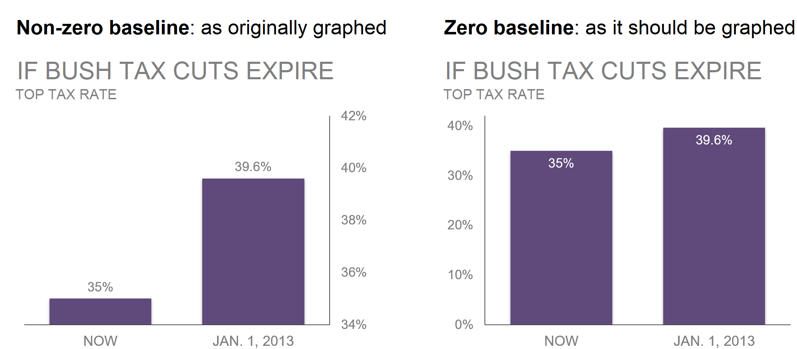
Framing
Framing is the way that a statistic is reported.
Context or comparison groups can influence the interpretation of the statistic.
Calculating proportions instead of actual numbers sometimes helps provide the true frame.
When people visualize data, they choose what to highlight and what to leave out of the visualization. These choices have framing effects that impact how others interpret the graphs and they take away from the content.
Notes:
Data Feminism pg 82
Image from Storytelling with Data – pg 51. Exaggerated version was used by fox news.

Slide 7
Misuse of Statistics
To the question "can statistics be manipulated?", we can address 6 methods often used - on purpose or not - that skew the analysis and the results. Here are common types of misuse of statistics:
Faulty polling
Flawed correlations
Data fishing
Misleading data visualization
Purposeful and selective bias
Using percentage change in combination with a small sample size

Slide 8
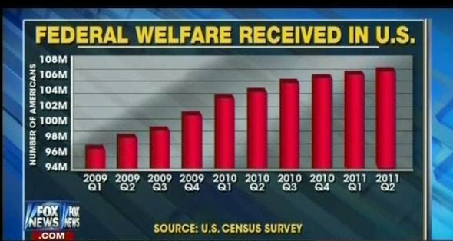
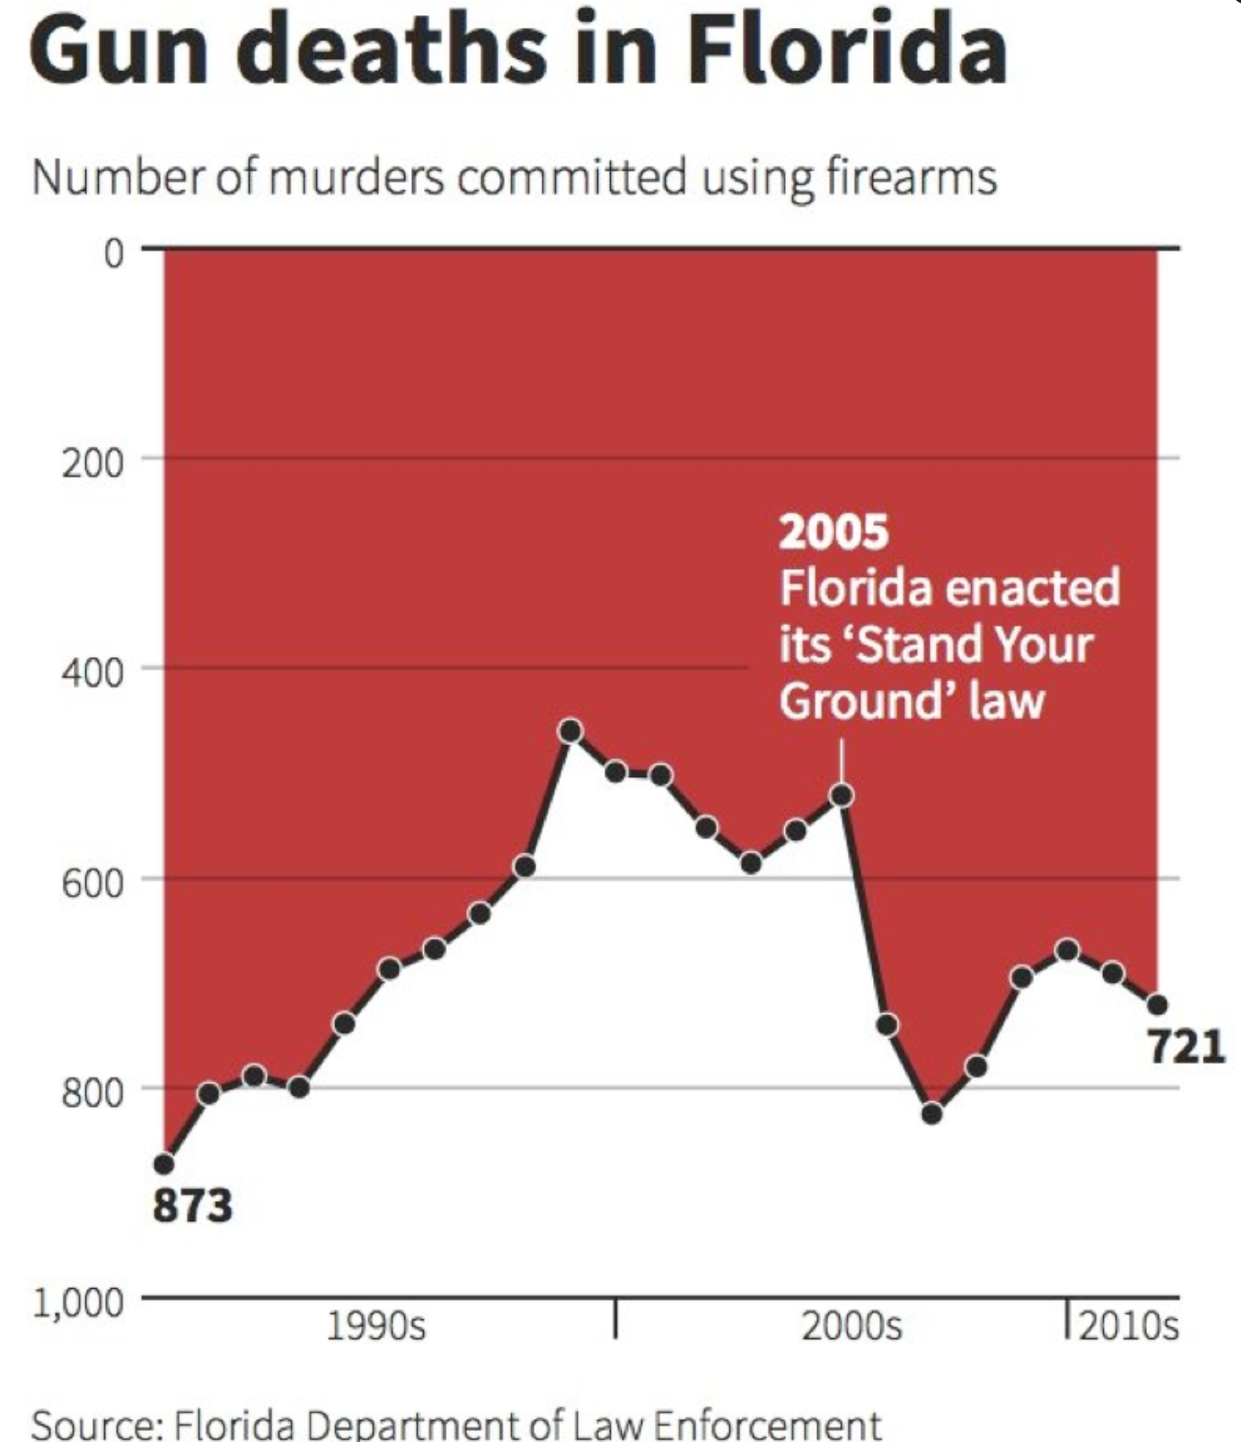
Notes:
Florida graph was meant to use the same imagery as a graph that charted deaths in Iraq (blood dripping) but that design aspect did not carry over into their graph which made it look misleading even though it was not intended to be that way according to the creator.

Slide 9
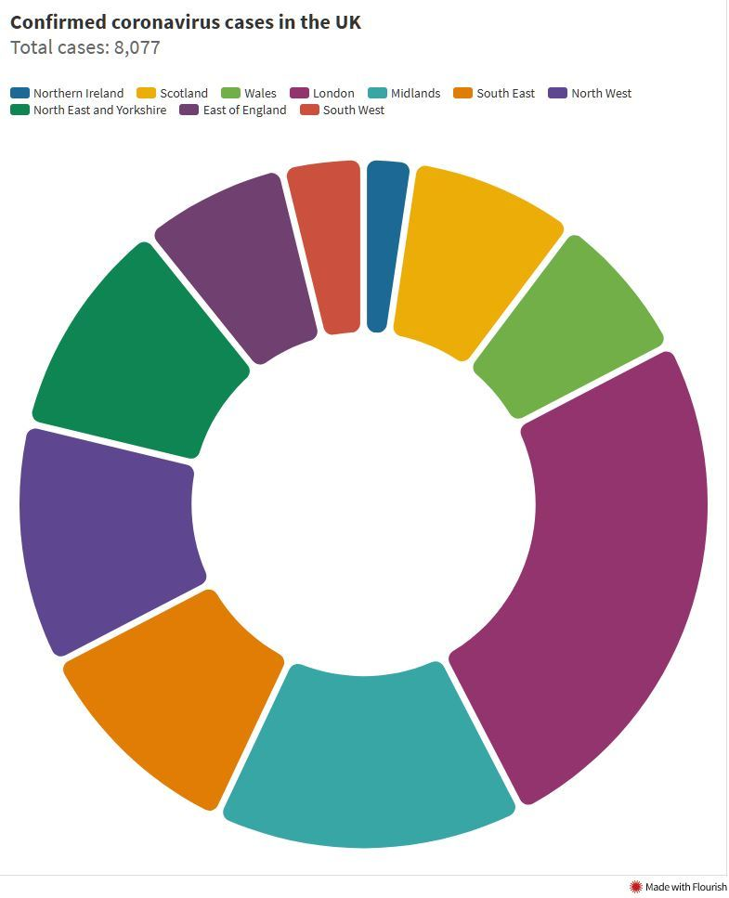
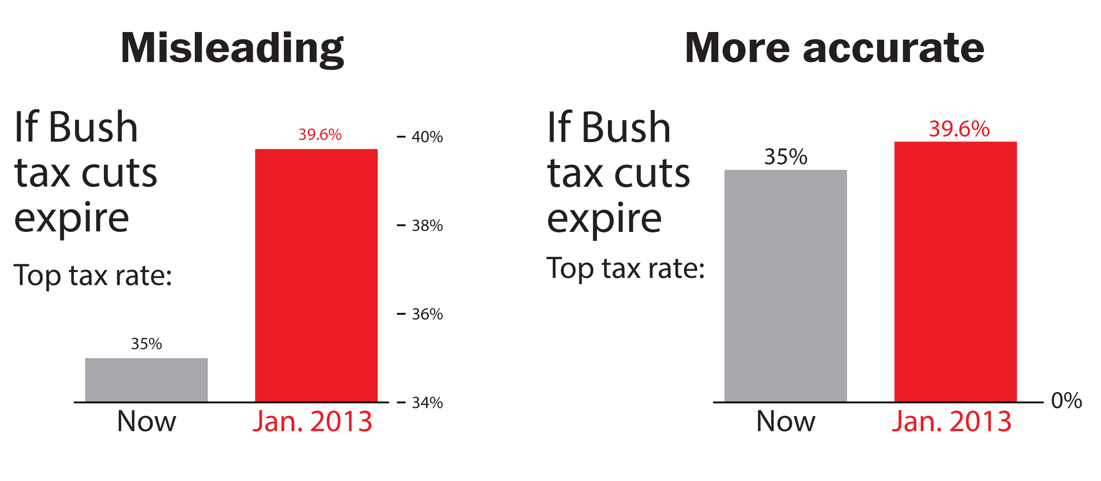
Avoiding bad graphs
Notes:
Bad graphs: https://venngage.com/blog/bad-infographics/
Bad graphs can be different than misleading graphs. Some people just aren’t very good at conveying information. Some people are good at conveying information in ways to intentionally misrepresent the data.

Slide 10
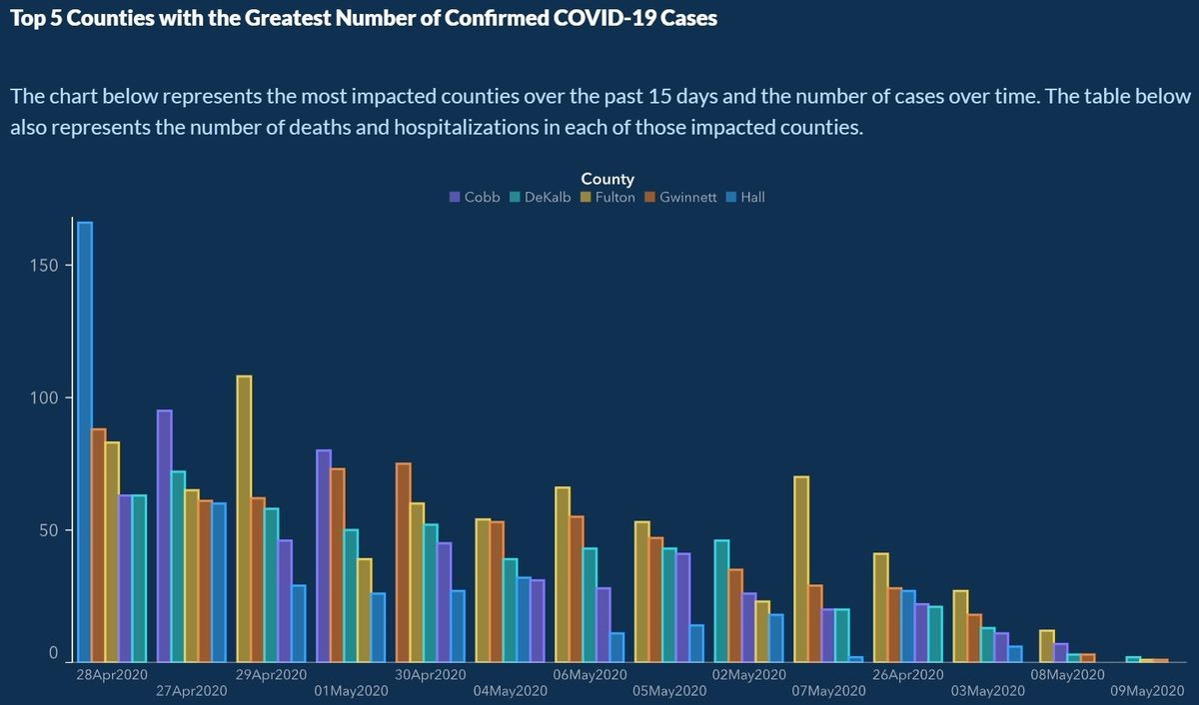

Slide 11
Measurements Matter
A city reports that one specific street recycles 2.2 times as much as any other street.
Are the streets the same length?
Do equal numbers of people live on the streets?
Alternatives:
Recycling amount per living unit
recycling amount per person
Compare it to the amount of trash
Notes:
Measuring recycling at the street level isn't a useful statistic unless streets are otherwise identical.
We want to adjust the amount recycled to take into account the number of people on the street.

Slide 12
Example – Water Usage
Some places compare themselves to other districts or cities when defending their water usage
Total water usage is down! (but population may have also decreased so the amount of water used per person may have actually increased)
Total water usage for a town is lower than everyone around us! (but very few people live in the area due to large houses with lawns and many golf courses. The per person water usage becomes astronomical compared to other locations)
Alternatives:
- water use per acre when considering different land uses
- Calculate per capita usage instead of raw numbers
Measuring the water used per capita per day.
Has that amount been increasing or decreasing per person as the population has changed?
Notes:
Findings show that water usage is highest for wealthy neighborhoods with large properties.

Slide 13
Discussion
What is the role of statistics and data analysis in public policy, public administration, and civic technology?
What examples do you think of? What have you seen lately?
Why does it matter?
Notes:
Other examples:
Travel time and congestion – major road project may be completed and travel times may not change BUT maybe extra cars are now on the road so the carrying capacity increased.
(There’s a lot of research and theory on congestion – adding lanes does not help travel time.)

Slide 15
Data Sources
Primary vs. secondary data
Primary – first-hand account of an event /or time. You are creating the data yourself.
Secondary – You are using someone else’s dataset for your analysis
Who collected it, how was it collected, why was it collected?
The data that shapes information systems are created by a small group of people
Data created by dominant groups and their perspectives influence the decisions being made during the data collection, cleaning, and analyzing process
If you don’t face daily struggles, you fail to notice a lot of things that cause problems for other people (workplace accommodations for mothers, accessible entrances, )
Limits the ability to predict and prevent harm, identify existing problems in the world, and to imagine solutions
Algorithms of Oppression – Safiya Umoja Nobel: gender and racial biases are encoded
Data Feminism – Catherine D’Ignazio & Lauren F. Klein
The Library of Missing Datasets – Mimi Onuoha
Notes:
The Library of Missing Datasets
Data Feminism – pg 33
Joy Boulamwini (MIT graduate student) noticed that the facial-analysis software she was working on for a class project couldn’t recognize her face. The AI had used a dataset of mostly white faces for learning. Only 4% of the faces in the dataset were of black women.

Slide 16
Observational data: information collected without the presence of an explicit experiment—it comes from surveys, government administrative data, nonprofit service delivery, and other sources.
Usually by obtaining and combining several datasets, researchers look for various opportunities to examine the causal effects of policy changes with statistical methods. These statistical methods, broadly called causal inference statistics (or quasi-experiments), take advantage of differences within populations, or policy changes over time and geography to estimate how effective a service or intervention is.
While big data can offer new insights, there are important statistical differences when analyzing big data. Most notably, it is generally harder to get data that accurately represents the whole of a population (like a country or a state). Cloud computing and modern software may easily enable analyzing multi-billion row datasets, but that makes it no easier to know who the data is relevant to. Phone records can illuminate strategies to improve traffic patterns, but does it overlook people without mobile phones? Credit card transactions can reveal lifestyle differences across socio-economic groups, but what could be missing without seeing cash transactions and cash-only consumers? This remains a large problem for effectively using big data that is not originally meant for social science (sometimes called “found data”).

Slide 17
“Even for public servants who never write code themselves, it will be critical to have enough data science literacy to meaningfully interpret the proliferation of empirical research.”
Notes:
https://www.brookings.edu/research/what-all-policy-analysts-need-to-know-about-data-science/

Slide 18
Accessing Public Data
ICPSR – Archive of data used in social and behavioral science research. You can search topics and phrases and filter by data format, funding agency, year published, etc.
Chicago Data Portal – 311 calls, demographics, parks, city employees, permits, and locations of libraries, parks, schools, etc., plus any more topics and datasets
Data.gov – NASA, EPA, Defense, FEMA, + other government departments and their open data
UIC's data sources - UIC has a list of data sources of various types categorized as "Research Tools" and "Policy Documents." If you don't remember what your options are, this is a good place to start. Links to HUD, American Community Survey, USA Gov, CMAP, National Low Income Housing Coalition, Chicago Data Portal, just to name a few. UIC also allow students to access other large data repositories such as ICPSR, Policy Map, and more.
Notes:
All of these are secondary data sources.

Slide 19
Opening data in Excel
Common file types:
.csv
.xlsx .xls .xml .xlsb .xlsm
.txt
.ods
File types Excel can’t open:
.dta, .sav & more (But R can open and use these files!)
Notes:
If I find a really great study on ICPSR, but they only include Stata code (.dta) then I can’t use that in Excel. ☹

Slide 20
Files in Excel
Look at the file. How is it formatted? How many rows? How many columns?
Is data separated by commas, spaces, semi colons?
Import data:
Open Excel > Data > From Text/CSV > Select File
Delimited text file: each item on a line of text is separated by a character (the delimiter). Most common type uses a comma (,) but other characters can be used too.
Fixed-width text file: All items are a set amount of space apart. Visually, the data appears in columns because of the spacing.

Slide 21
Chicago and WID example
If you format or create graphs in a CSV file and save/close it, only the text in the file will be kept.
Save As -> Excel file if you want to save your formatting and graphs!!

Slide 22
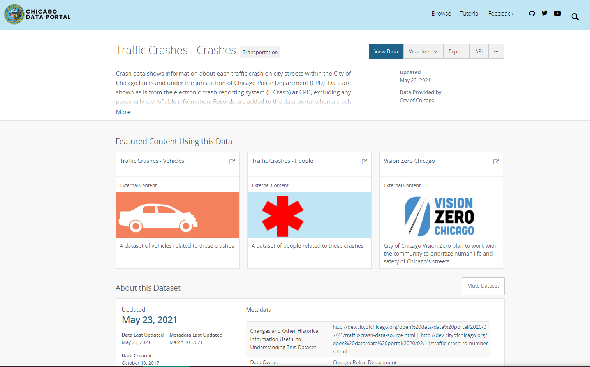
Download Chicago Traffic Accident Data
Research Question: How did COVID-19 restrictions impact traffic in Chicago?
Hypothesis: Work restrictions led to fewer drivers and therefore fewer accidents.
Went to Chicago Data Portal
Chicago data portal also has a github
Before we download, let’s click “View Data” to see if this is what we want.

Slide 23
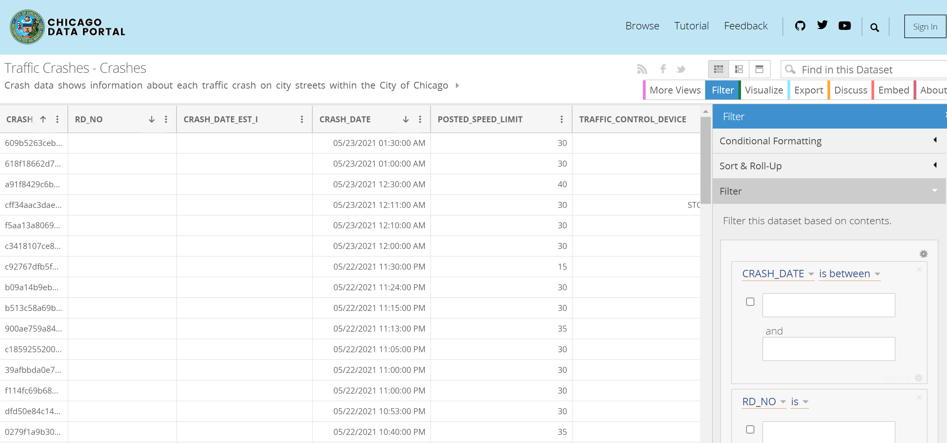
Notes:
Chicago’s data portal has a relatively user-friendly interface that allows filtering, sorting, formatting, and visualizing of data before you even download the data. Many data sources do not have this. You would instead have to read the description of the dataset, descriptions of the variables, and other information provided to determine if it was what you wanted to analyze.
API information: https://dev.socrata.com/foundry/data.cityofchicago.org/85ca-t3if

Slide 24
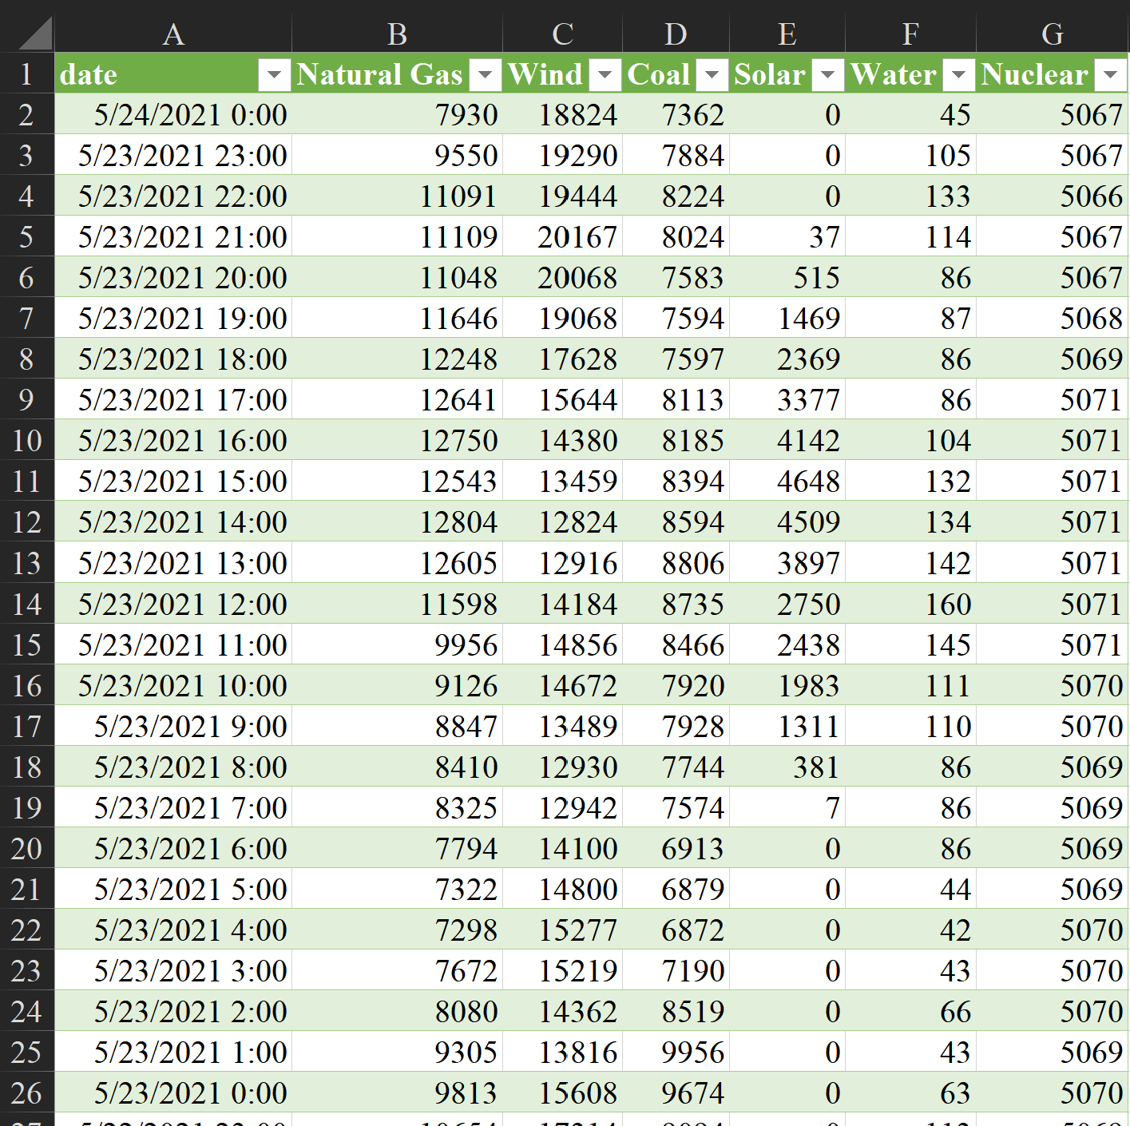
Sort & Filter buttons
Column Headers
Table Column
Table Row
Table Cell
Notes:
The row is your observation.

Slide 25
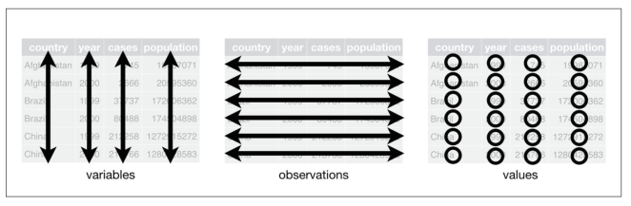

Slide 26
Complete Handout before Leaving

Slide 27
Week 2

Slide 28
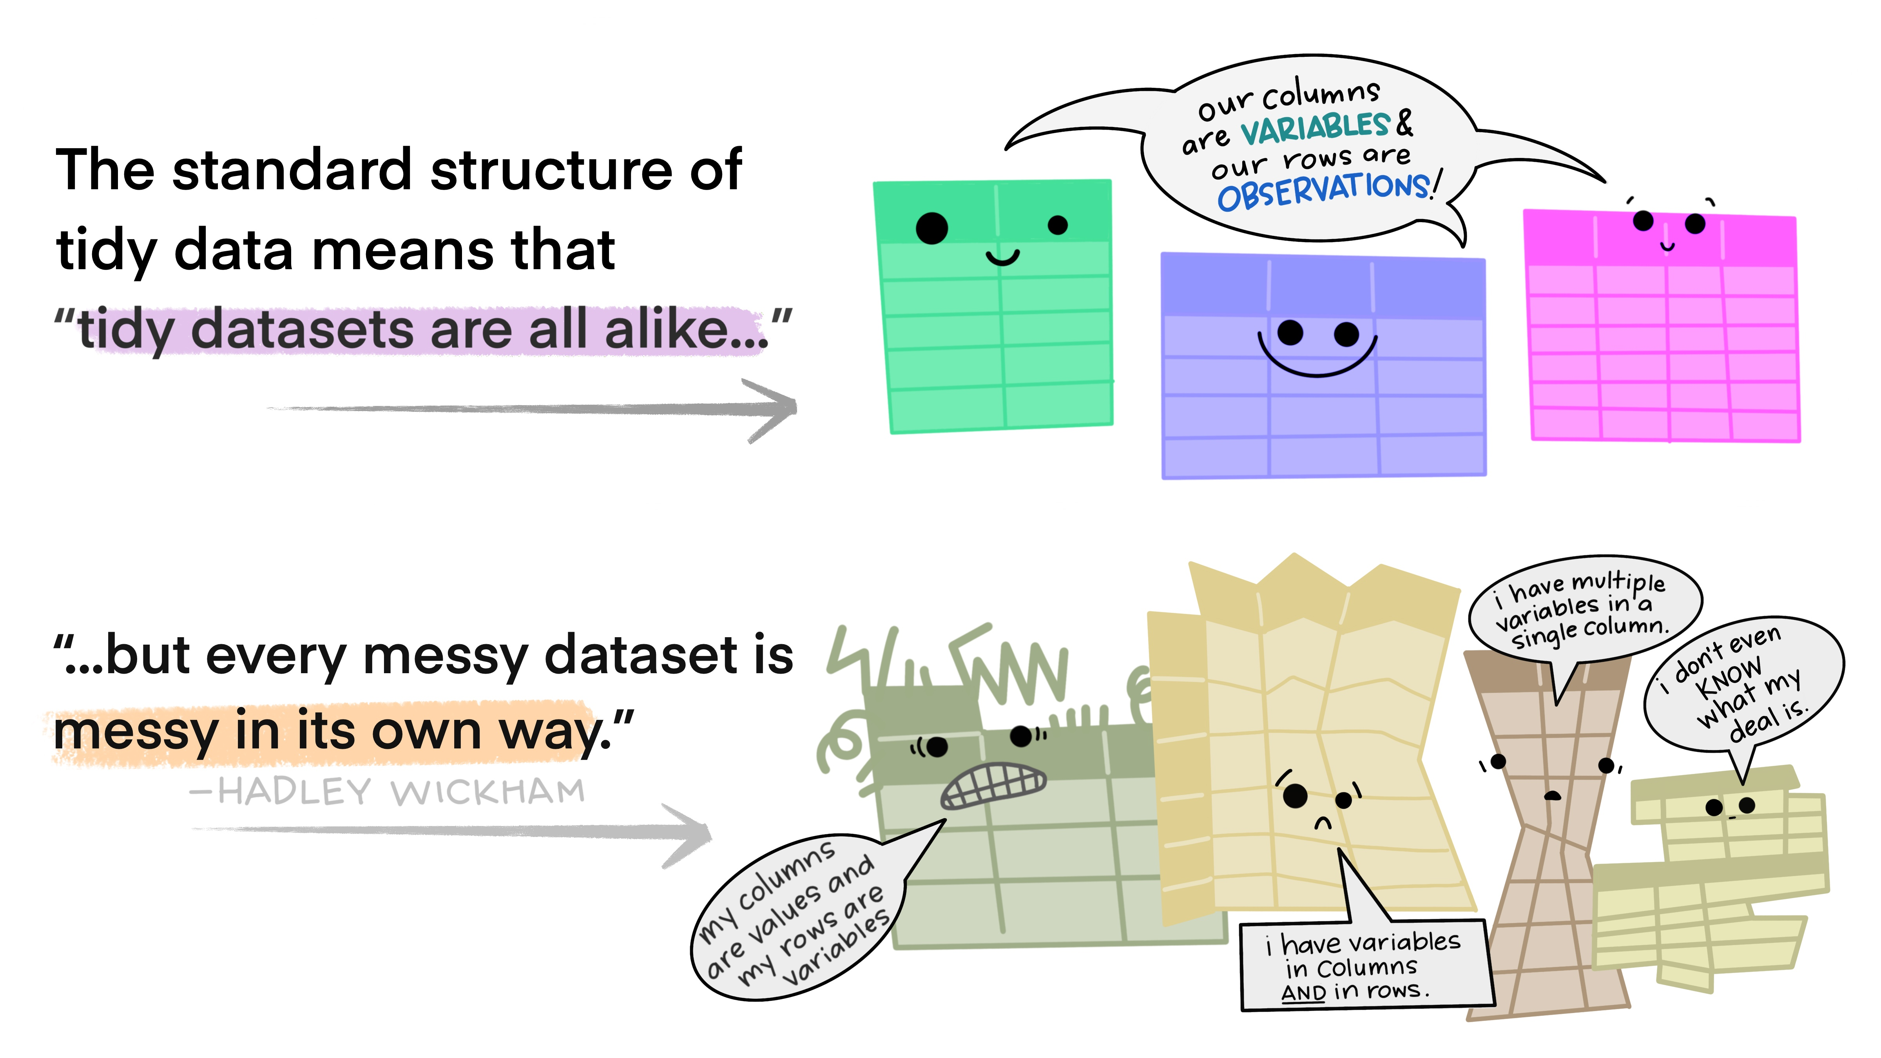
Data Management
Data will very rarely be organized the way that you want
.

Slide 29
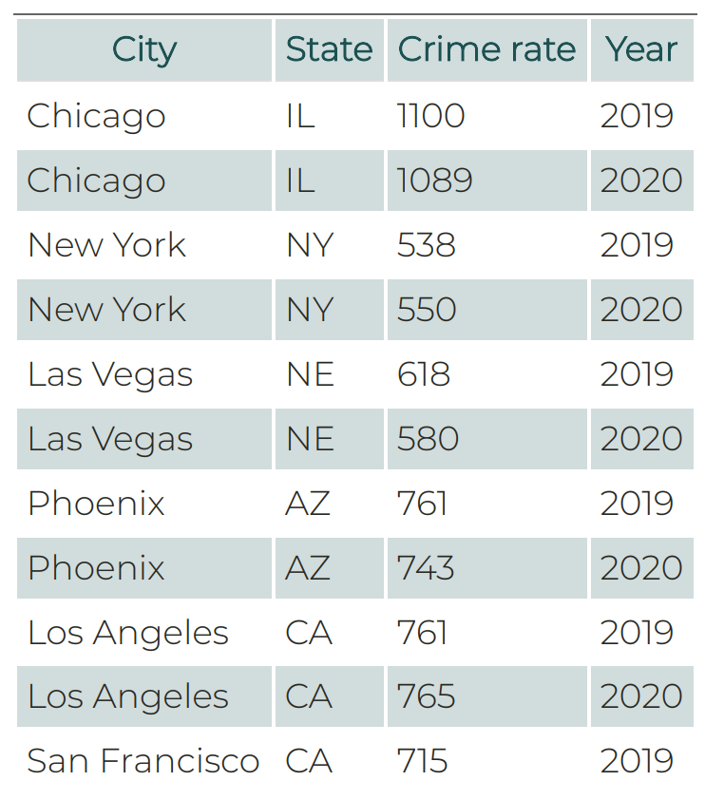
Data Structure
Good (aka “Tidy”) Data
Each variable should have its own column
Each observation must have its own row
Each value must have its own cell
Rectangular Data: Rows indicate observations, or cases, and columns indicate variables
Excel tables
R dataframes or tibbles
Notes:
Note: A variable is a quantity, quality, or property that you can measure. An observation is one unique unit of analysis (e.g., a country, a country in a given year). This depends on your analysis Values are all the individual cells in your datasets which are stored in variables or observations

Slide 30
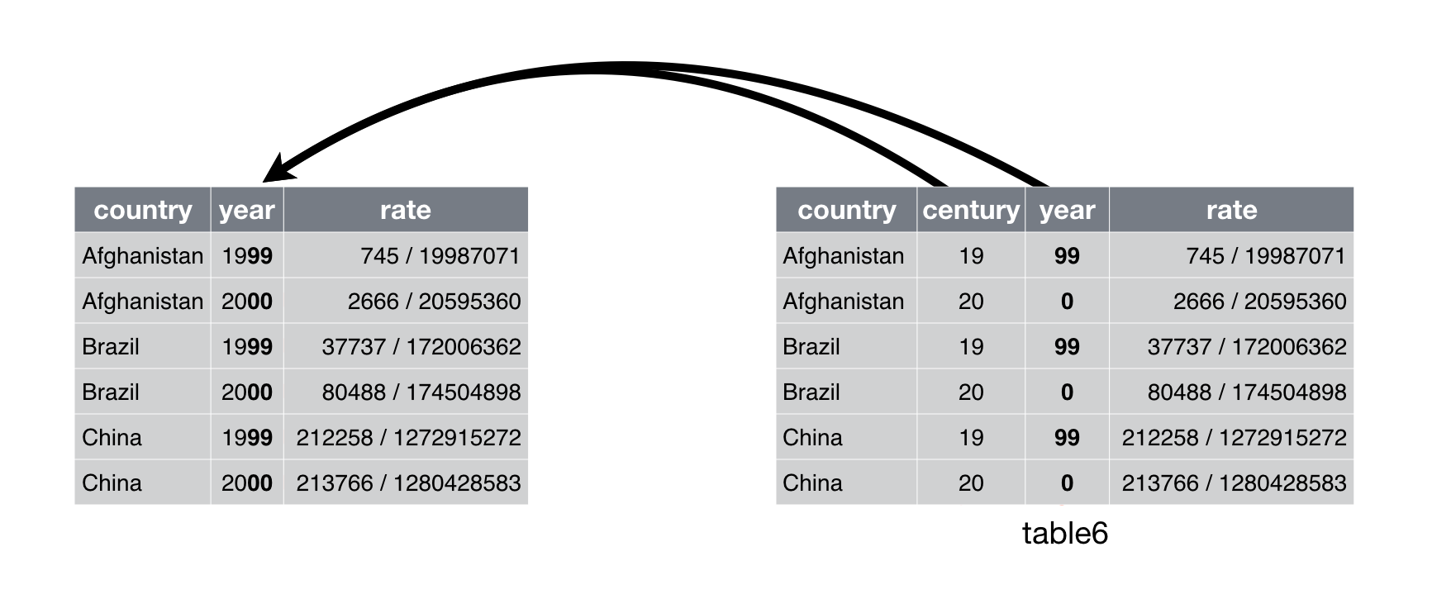
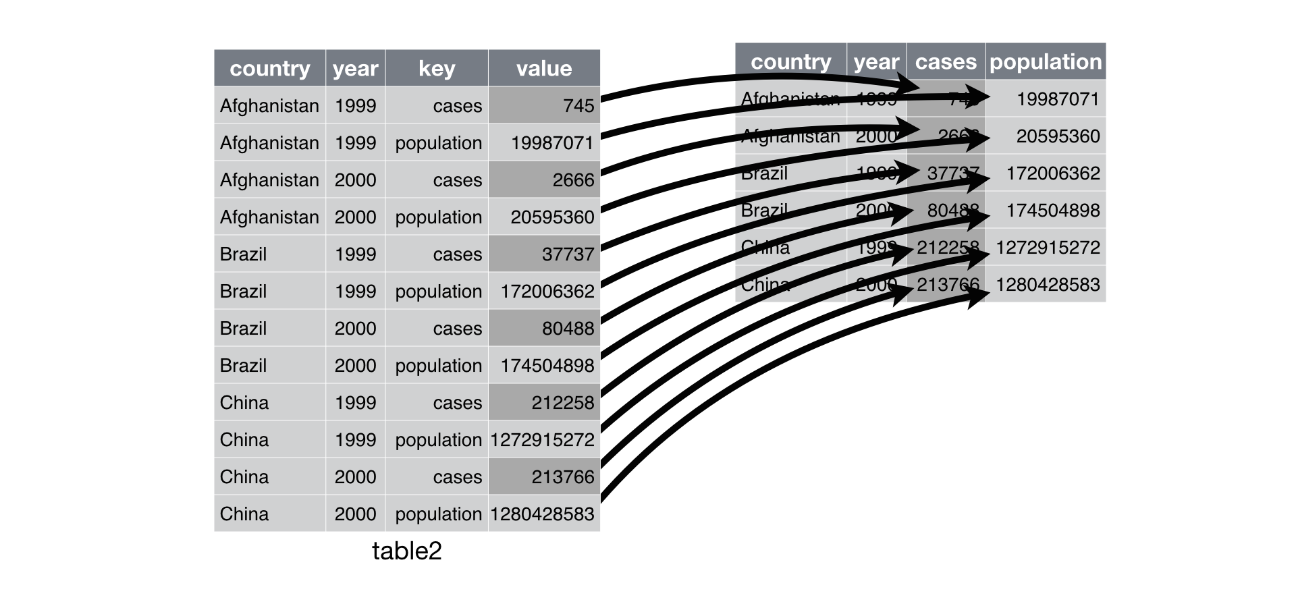
Notes:
Images from Chapter 9 – Tidy Data with tidyr

Slide 31
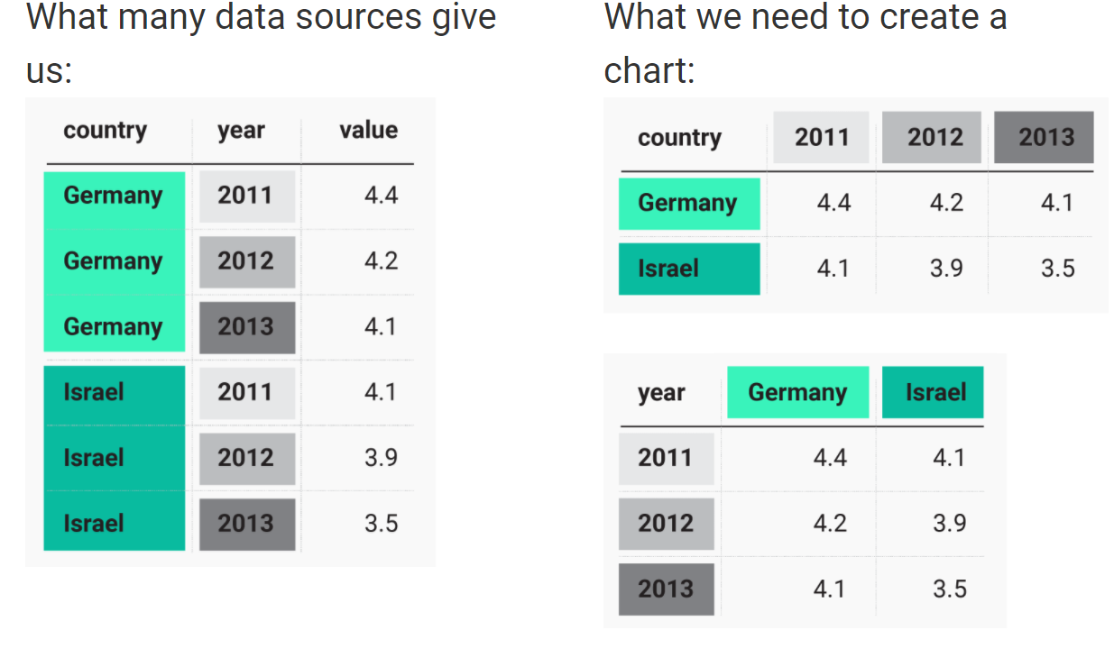
Wide vs. Long Format
Long Format: Each observation is in its own row
Allows you to add as many variables as you want
You can look at responses for an age group, in a country, during a specific year.
Wide Format
Multiple values in a row (multiple years, countries, etc.)
Only 2 variables at a time (country and year, gender and age group, etc.)
Notes:
Image from https://blog.datawrapper.de/pivottables/
Pivot Tables can do this!

Slide 32
Pivot tables are tables in Excel that summarize data from the original table.
Ex. If you have the amount of electricity used by each household and business in county, you could calculate the average amount of electricity used by each county or state.
Pivot tables help go from long format to wide format
In R, the commands are pivot_longer() and pivot_

Slide 33
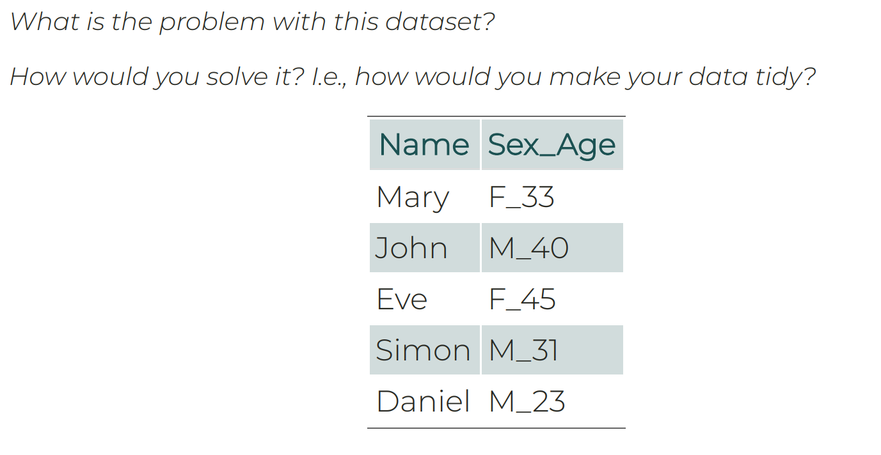
Messy Examples
Add photos of disaster declarations – state – year in wide and long formats
Notes:
Why would this data be challenging to work with? How would you improve it?
What are the variables of this dataset?

Slide 34
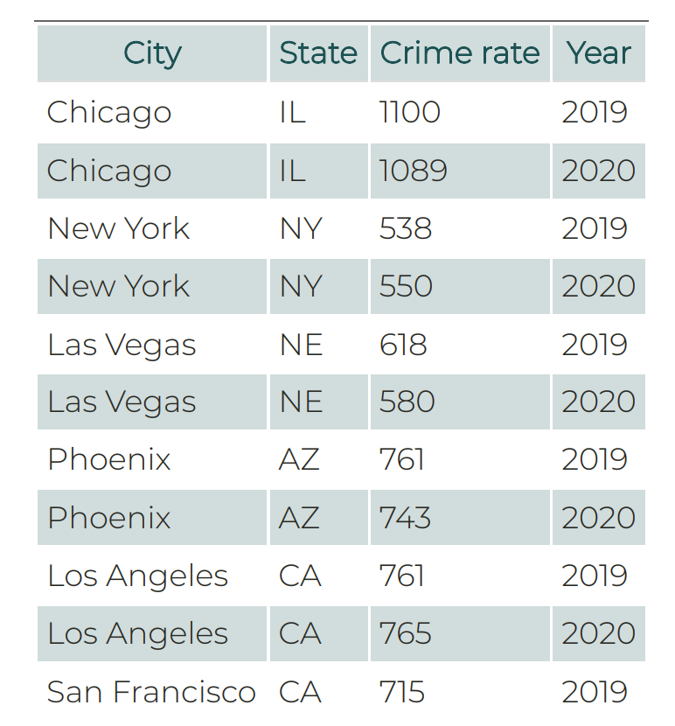
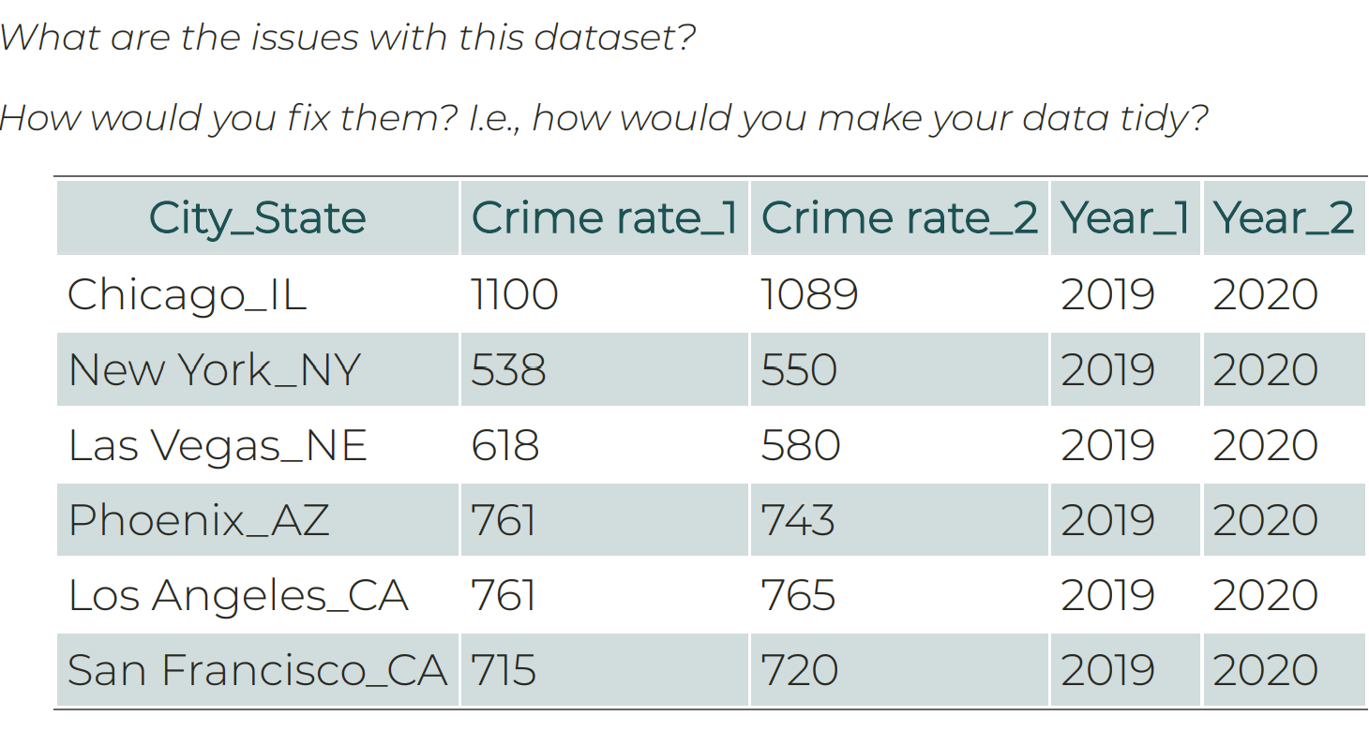
Example
Notes:
First separate city and state into separate variables. Then you want year as one variable and the crime rate as another variable.
Once we get to R, we will use commands like pivot_wider and pivot_longer to do what we described here. Each row is one observation (a city during a certain year)

Slide 35
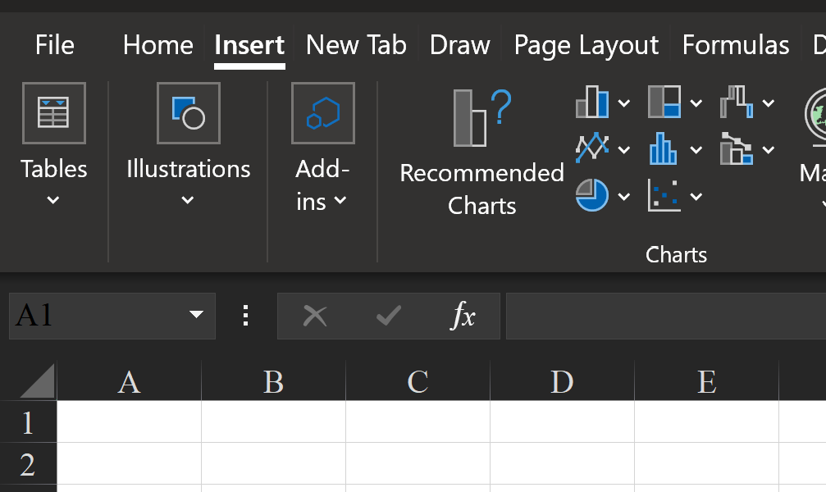
Excel Tables
An Excel table is a rectangular range of cells used to store data
- Tools for entering, editing, analyzing data
Create an Excel Table:
Select all data in excel sheet > Insert > Tables > Table
- Or click on any cell in the data, Insert > Table
Notes:
Data: Traffic_Crashes_SMALL
I only kept crashes that happened on Oct. 31 (310 of 222,718 observations)

Slide 36
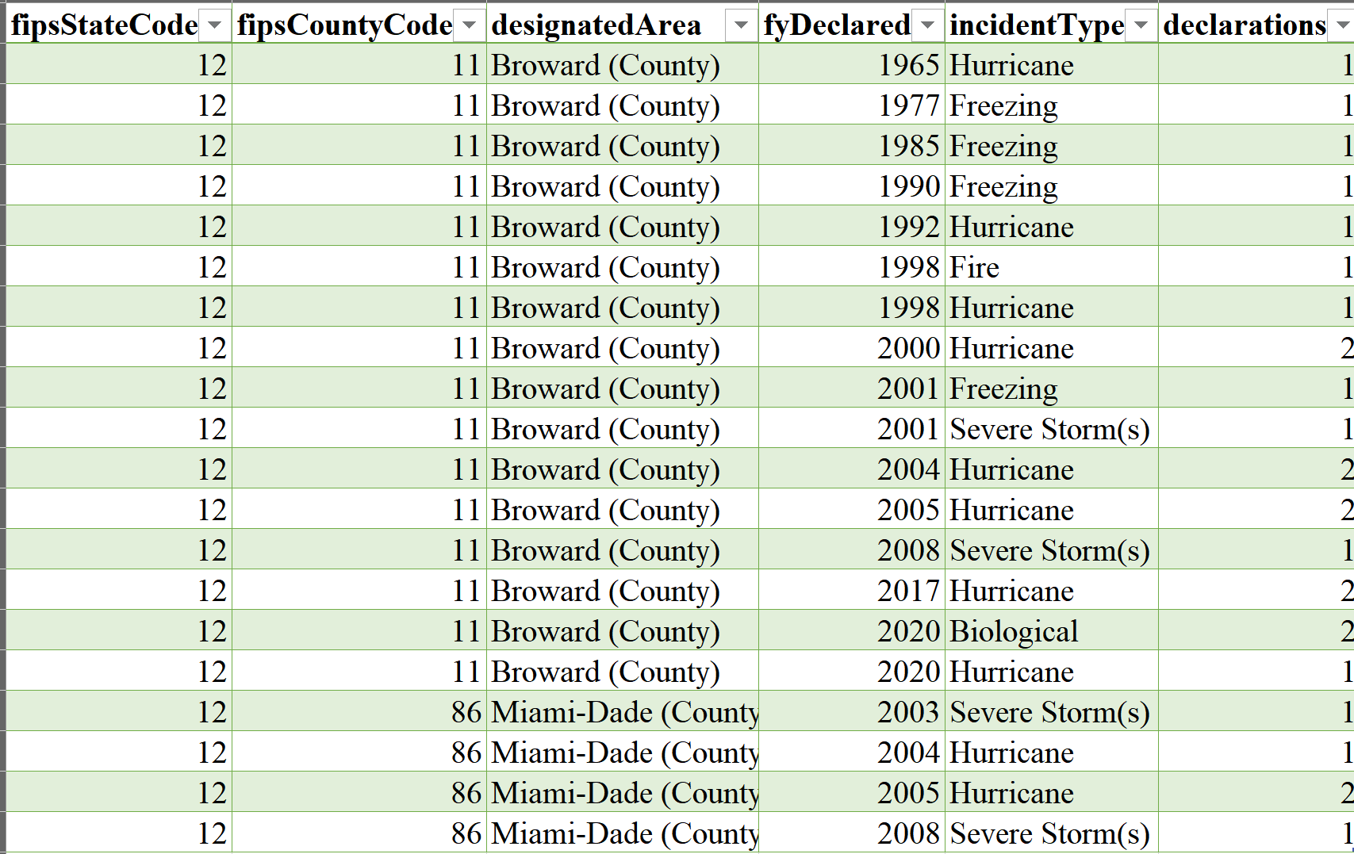
Notes:
Which format is this?

Slide 37
Pivot Tables & Pivot Charts
Insert > Pivot Table > Select all in the “Table/Range” area > OK
Select the variables you want to summarize in PivotTable Fields
- What does each row represent?
- What does each column represent?
Pivot Charts do not choose the appropriate graph for you.
Shortcut for Pivot Chart ➔ Click on any cell in the pivot table and F11
Notes:
Excel for Dummies pg 177
Chapter 9

Slide 38
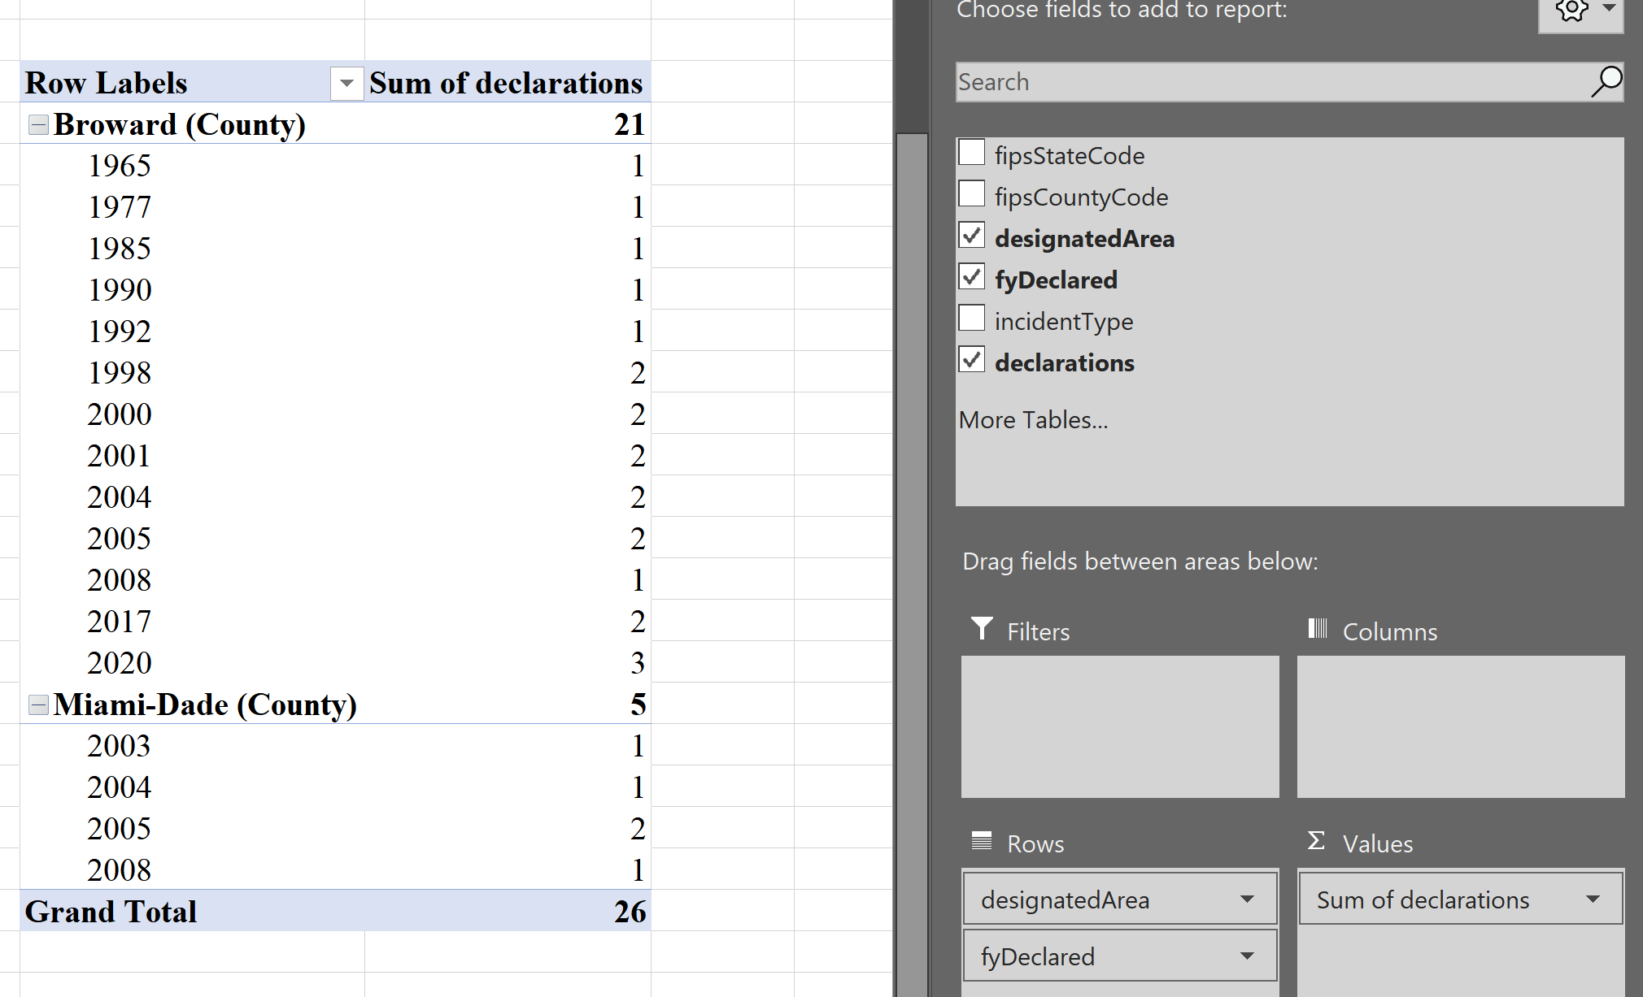

Slide 40
Data Cleaning
Common Steps:
Delete unnecessary columns or create a separate file containing only columns you need
Delete unnecessary rows
Resize columns
Resize rows
Column format: Text, numeric, percentages, etc

Slide 41
Common errors in datasets
Duplications: where one row contains identical/similar information to another row.
‘NA’ misclassifications: where empty values are misclassified as known values or vice-versa.
Erroneous answers: where incorrect values are entered, either accidentally or deliberately (a common effect of compulsory questions that cannot be answered).
White space and alphabetical case errors: where values appear to mean the same thing but are classified differently due to white space or alphabetical case.
Spelling mistakes, typing errors, or special character errors: where values appear to mean the same thing but are classified differently.
Inconsistent time formats: where dates/times have been inputted in several different time formats, making it impossible to make time-based calculations.
Data merging ambiguity: where information that could be recorded in different columns is merged into one column, making the information difficult to interpret.
Data recording ambiguity: where information is recorded in different ways (e.g. giving a range of values rather than a single value).

Slide 42
Download Chicago Traffic Accident Data
Research Question: How did COVID-19 restrictions impact traffic in Chicago?
Hypothesis: Work restrictions led to fewer drivers and therefore fewer accidents.
Went to Chicago Data Portal
Chicago data portal also has a github
Before we download, let’s click “View Data” to see if this is what we want.
Notes:
Use Traffic_Crashes_SMALL

Slide 43
Notes:
Chicago’s data portal has a relatively user-friendly interface that allows filtering, sorting, formatting, and visualizing of data before you even download the data. Many data sources do not have this. You would instead have to read the description of the dataset, descriptions of the variables, and other information provided to determine if it was what you wanted to analyze.
API information: https://dev.socrata.com/foundry/data.cityofchicago.org/85ca-t3if

Slide 44
Looks good, let’s use it! Downloaded Traffic Crashes Dataset
If we want to know ____ what do we need to answer that question?
Notes:
The file downloaded on 5/23/2020 was 88.3MB large. For some computers, this may be a large file to open and manipulate in Excel without frustrating lags.
To answer the research question and make the data more user friendly, let’s delete rows that are not needed. I deleted all observations before 2019 and columns that were unnecessary for the class examples.

Slide 45
Descriptive Statistics
Describing the data
Maximum value
Minimum value
Range: Maximum value – minimum value
Sum: Adding together a range of values
Frequency: Number of observations
How many people got vaccinated in an area?
What is the median income?
What is the average age of someone within a program?
What is a school’s graduation rate?
How many meals were distributed at the local food shelf?
Notes:
How many people got vaccinated in an area?
What is the median income?
What is the average age of someone within a program?
What is a school’s graduation rate?
How many meals were distributed at the local food shelf?

Slide 46
Exploratory Graphs
- Mostly made for you and your team
- Draw quick information from your data in a more intuitive way
- Several uses: better understand your data, find patterns in your data, suggest modeling strategies, debug your analysis
Three rules to keep in mind even when making exploratory graphs:
1. Data are displayed appropriately (i.e., the graph type matches the data type)
2. Clearly-labeled graph (e.g., axes' labels and title)
3. Axes that are not misleading
Notes:
Storytelling with Data pg 20

Slide 47
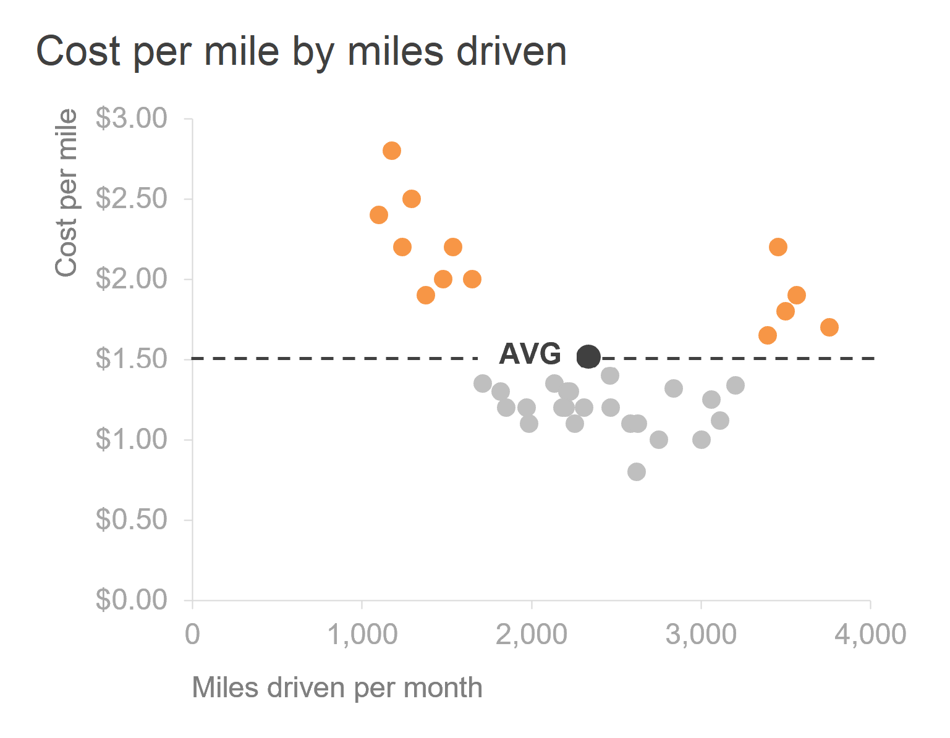
Explanatory Graphs
These are the fancy graphs that you see all around
- The "reader" is the audience
- Visually pleasing, well-designed graphs
- Usually created after your analysis
- It can take quite some time to get a graph "right“
Think National Geographic or The Economist graphs
Notes:
Storytelling with Data pg 111

Slide 48
Descriptive Statistics Practice
- How many crashes occur at different speed limits?
- Does weather impact traffic accidents? (Consider the number of days that are clear vs. foggy)
- Crash totals for each year or month?
- Hour of the day with the most accidents?
Notes:
Most of data analysis involves statistics.

Slide 49
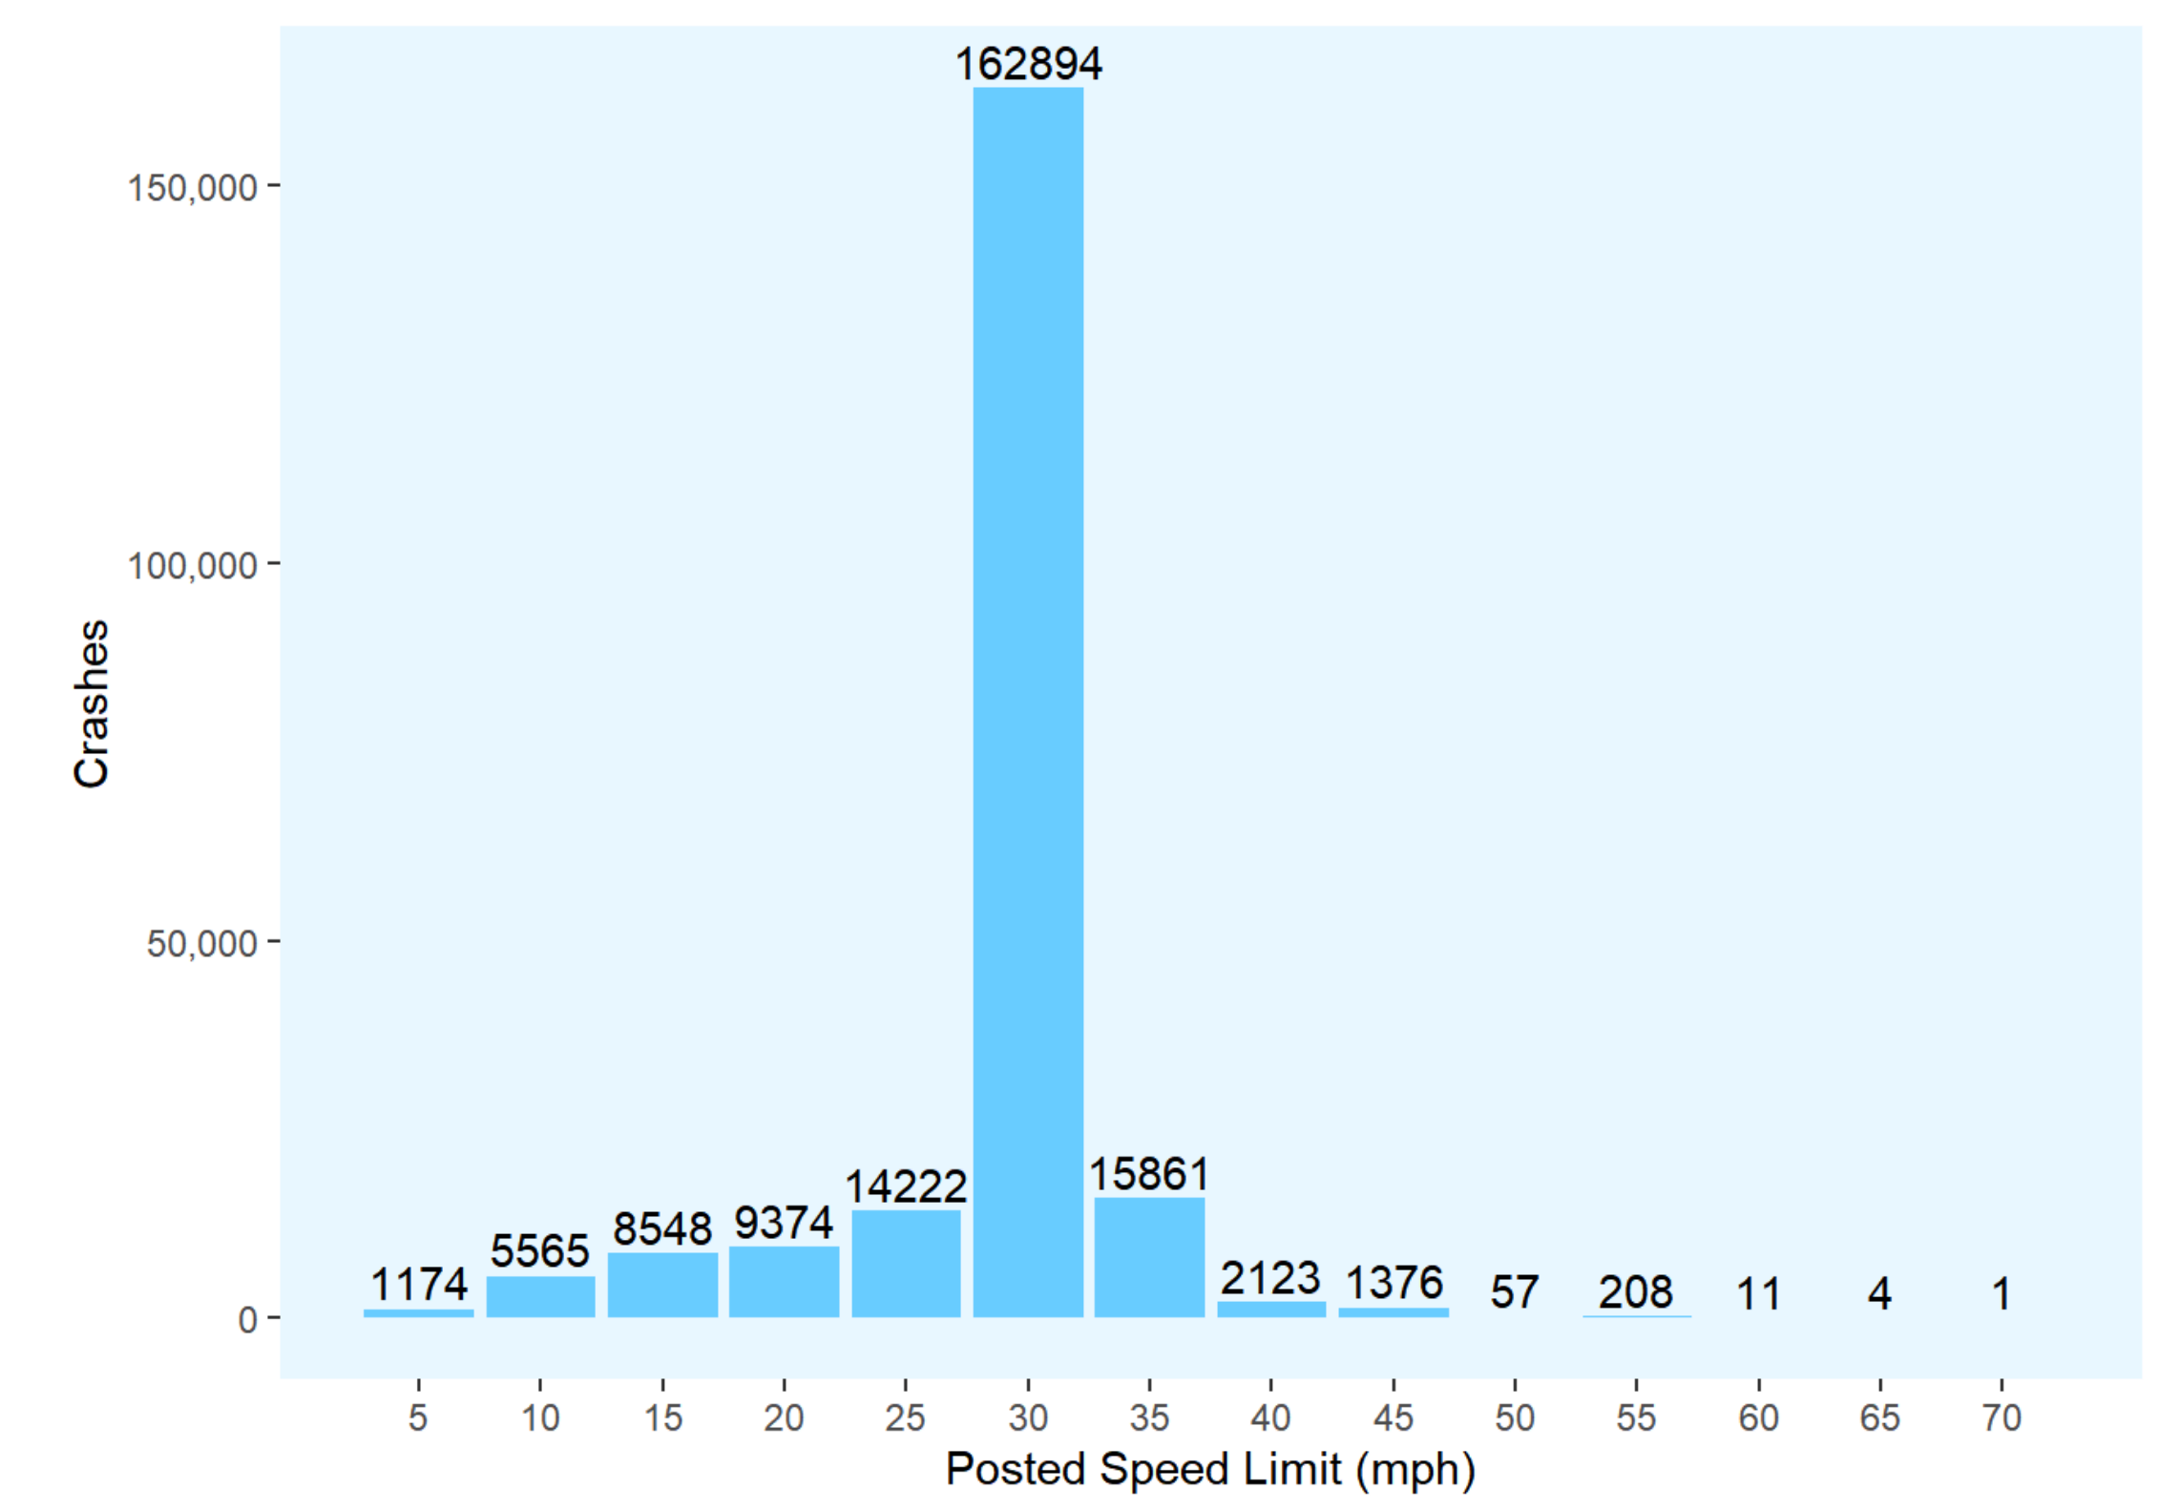
Chicago Traffic Accidents

Slide 50
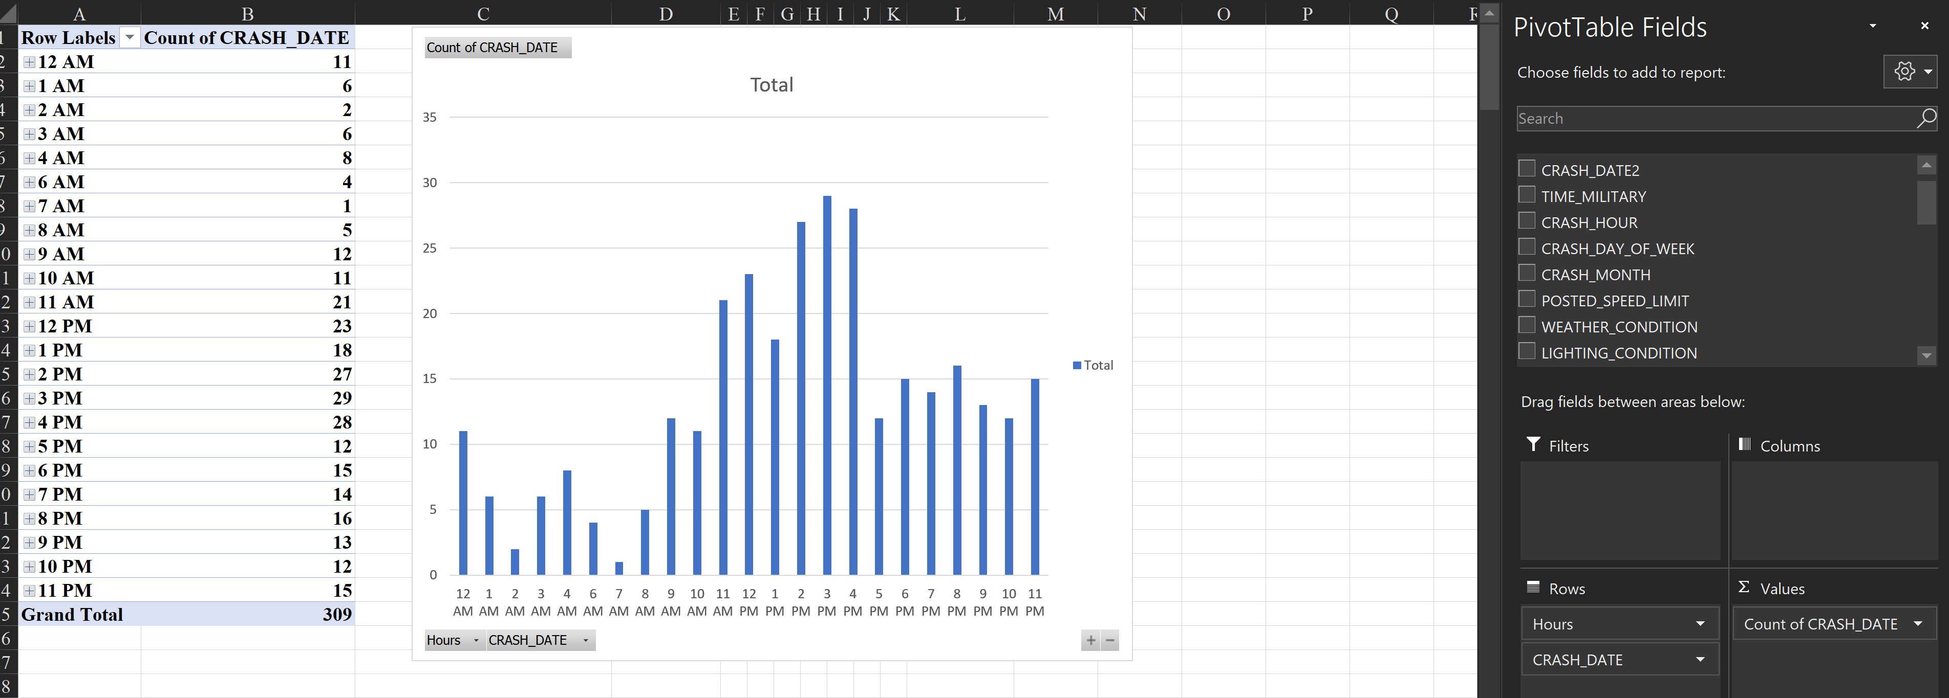
When did people have an accident?
Insert > Pivot Chart > Your table name should be in the box (Mine was Table1)
Notes:
Axis – Hours
Values – Count of observations

Slide 51
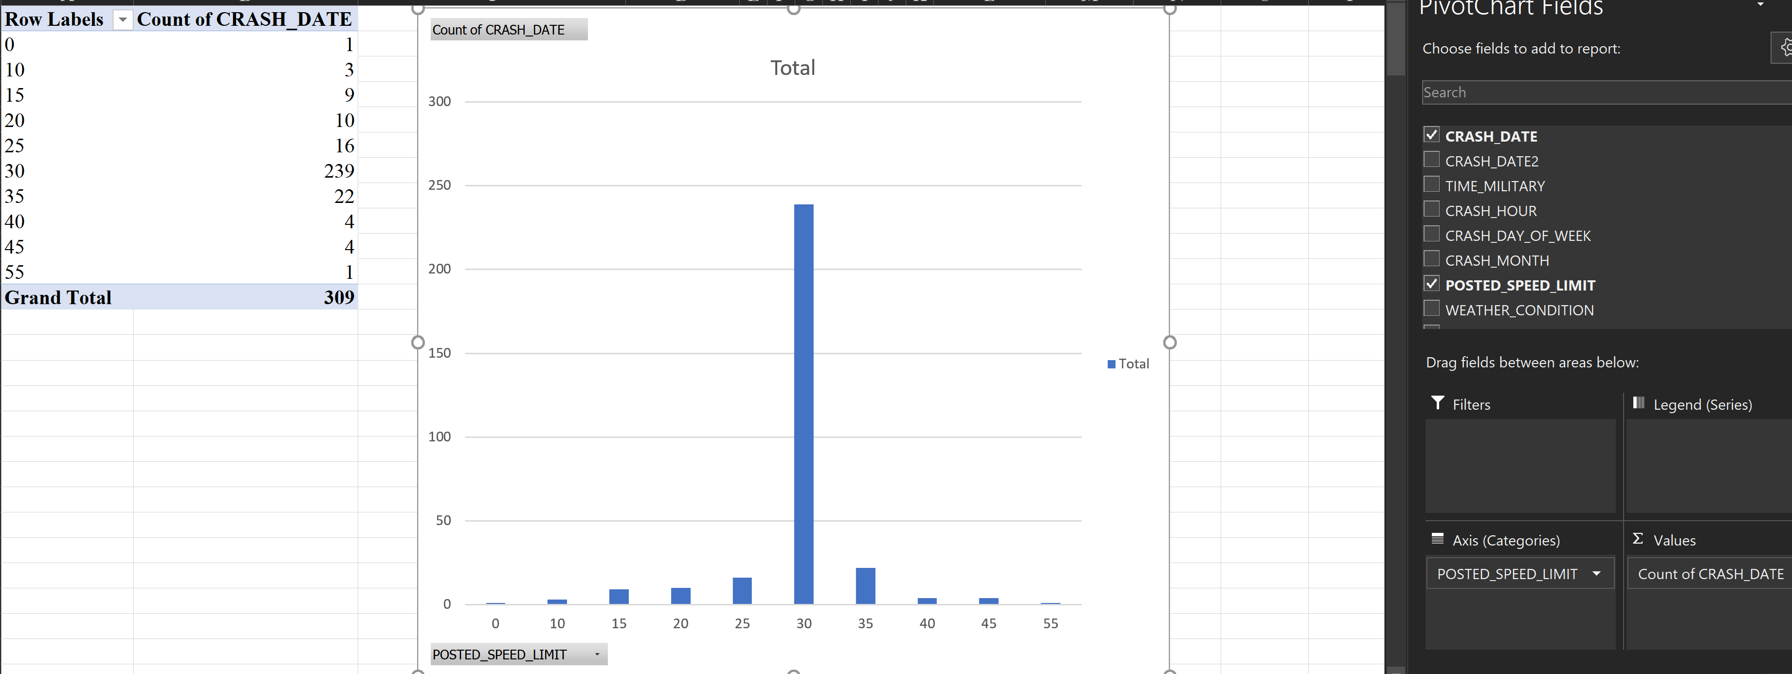
What were the posted speed limits?
Notes:
Axis – posted speeds
Values – Count of observations
Graph shows number of accidents that occurred within each posted speed limit.

Slide 52
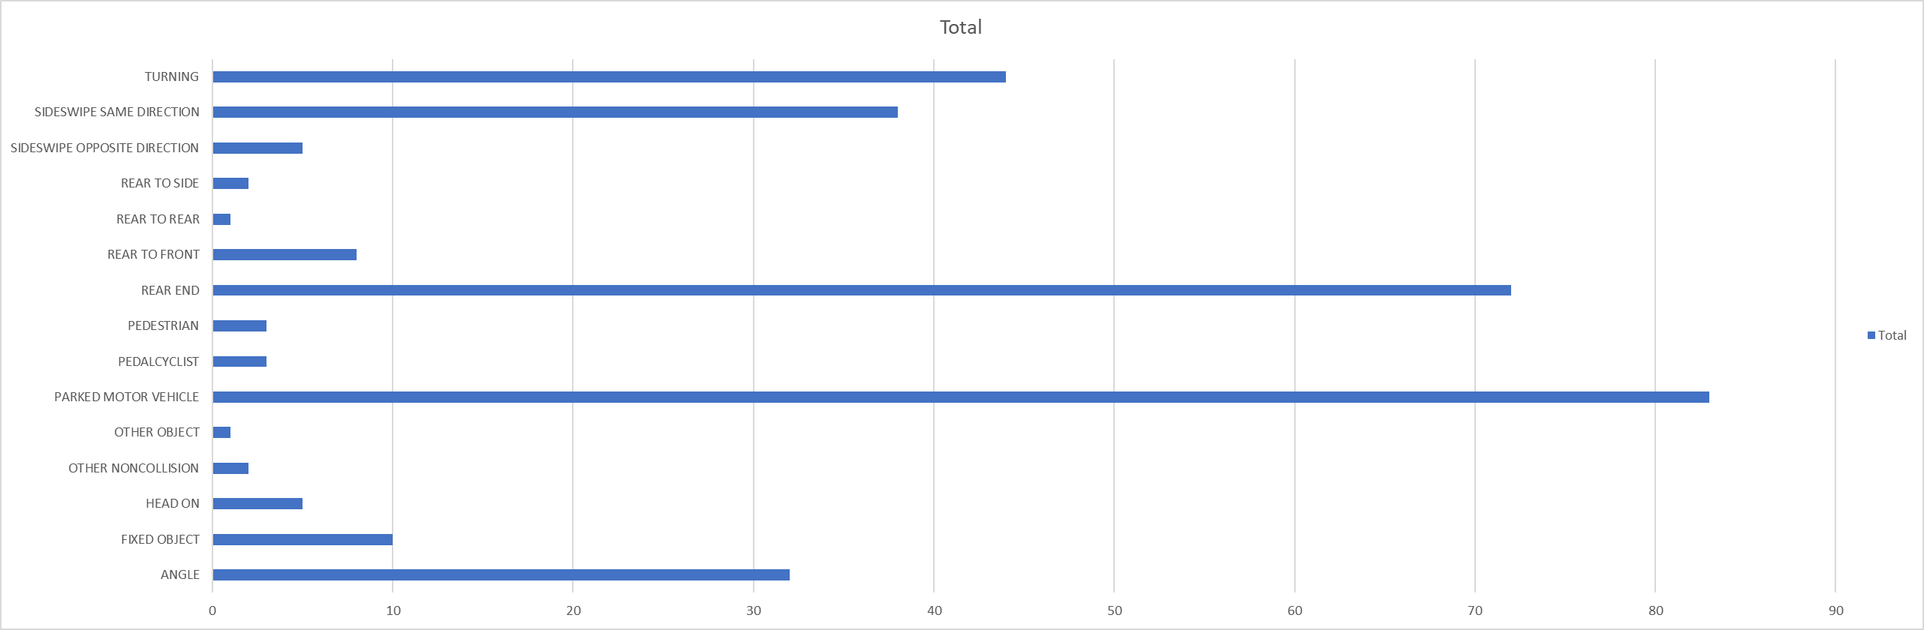
The Vertical Chart worked well when we had data with short labels, but what if we wanted to look at the weather recorded during the accidents?
Right Click > Change Chart Type
Notes:
Was done alphabetically by default

Slide 53
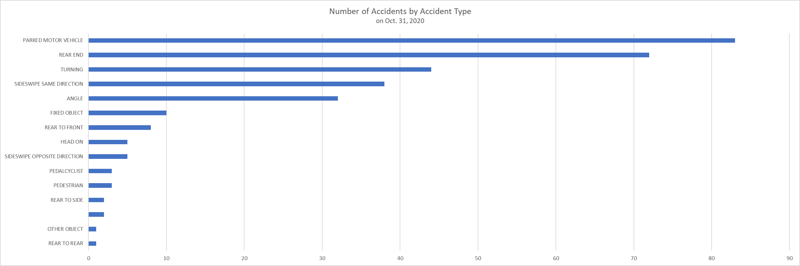
Horizontal Bar Graphs
One of the best for categorical data
If categories have a natural order (0-10 years old, 22-20 years old, etc.), keep categories in order
If categories do not have a natural order, use either ascending or descending order
If smallest is important, put it at the top and vice versa
Notes:
Storytelling pg 57

Slide 54
Cleaning Data
Date Column

Slide 55
Separating Cell Information
Insert a column next to the one you want to split
Data > Data Tools > Text to Columns > Convert Text to Columns Wizard > Deliminated > Next > Choose the delimiter to define places where you want to split the cell content
https://support.microsoft.com/en-us/office/split-a-cell-f1804d0c-e180-4ed0-a2ae-973a0b7c6a23

Slide 56
Combining Cells in Excel
https://support.microsoft.com/en-us/office/combine-text-from-two-or-more-cells-into-one-cell-81ba0946-ce78-42ed-b3c3-21340eb164a6
Combine data with the Ampersand symbol (&)
Select the cell where you want to put the combined data.
Type = and select the first cell you want to combine.
Type & and use quotation marks with a space enclosed.
Select the next cell you want to combine and press enter. An example formula might be =A2&" "&B2.
Combine data using the CONCAT function
Select the cell where you want to put the combined data.
Type =CONCAT(.
Select the cell you want to combine first.
Use commas to separate the cells you are combining and use quotation marks to add spaces, commas, or other text.
Close the formula with a parenthesis and press Enter. An example formula might be =CONCAT(A2, " Family").

Slide 57
Inferential Statistics (PPOL 205)
If you have a sample of observations from a population, then you can infer, or draw conclusions, about the entire population based on the characteristics of the sample.
Surveys
Opinion polls
Accuracy: You can never be 100% sure that your inference is correct because you only have information from a subset of the population. If you sampled incorrectly, you make some incorrect assumptions.
Predicting elections before votes are in
Notes:
PPOL 205 will cover inferential methods (hypothesis testing, t-tests, confidence intervals, regression analysis), but will do so through policy-relevant case studies, real data sets, and applied assignments.

Slide 58
Week 3

Slide 59
Recap of Last Two Weeks
If you enrolled late, talk to me after class.

Slide 60
Categorical Variables
A categorical variable is made of categories. Even if a number is assigned to it for data recording purposes, the numbers do not mean anything (eg. taking the average of: 1. Blue, 2. Orange, 3. Green). This occurs most often when analyzing survey data when information is stored as numbered responses (that work for analysis) and labels (that describe the options)
Mode, Expected Value (don't cover?), Bar charts, Line charts (avoid pie charts)

Slide 61
Numeric Variables
Continuous
Age,
Ordinal

Slide 62
Types of Variables
Nominal-Level Variable: mode Ordinal-Level Variable: mode, median ‘High’ Ordinal-Level Variable (7+ Categories): mode, median, mean Interval- or Ratio-Level Variable: mode, median, mean
Continuous: Data can take on any value in an interval
Discrete: Data can take on only integer values, such as counts
Categorical: Data can be only a specific set of values rerpresenting a set of possible categories (factors, nominal)
Binary: Categorical variables with only two options (Yes/No, 0/1, true/false, etc.). Synonyms include: dichotomous, logical, indicator, booleani
Ordinal: Categorical data that has an order to it. (A range of feelings, Likert scales, etc.)

Slide 63
Variation
Variation is the tendency of variables to change from measurement to measurement
Each measurement includes a small amount of error
Visualize the distribution of a variables values to find patterns in variation
Chicago traffic speed example

Slide 64
Appropriate statistics for describing variables
Nominal-Level Variable: mode
The values have no meaning, order of categories doesn’t matter
Ordinal-Level Variable: mode, median
The values have order, the direction matters
‘High’ Ordinal-Level Variable (7+ Categories): mode, median, mean
Interval- or Ratio-Level Variable: mode, median, mean

Slide 65
Texas Winter Storm
The ERCOT dataset contains hourly megawatt amounts from multiple power sources for January and February. Publicaly available.
Potential Descriptive Statistics:
Sum of hourly megawatts for each source
Average proportion of total energy provided from each source
Daily average? Yearly average? Monthly Average? Depends on what you are trying to understand.
Long term changes in power sources? Maybe average total megawatts from each source
Short term changes in power sources? Changes in hourly or daily megawatt amounts from each source
Visualize change over time: Insert Chart > Line chart for temperature. To chart temperature and energy sources, you can make a “Combo” graph. This is largely known as a double y-axis and must be used with caution. Graphs with double axes have been used to misrepresent data because the two y axes do not share a common scale.
Policy Context: Texas Governor Greg Abbott claimed that solar and wind were to blame for the power outages and that fossil fuels were the only reliable way to power electric grids. Other conservative leaders and influential talking heads said similar things across various forms of media.
Notes:
Highlighted columns in 'Energy', Insert > Pivot Chart > Sum of each power source in the value section. It automatically sums up the total power consumption by day if date is in the x axis.
Good graphs = labels, commas indicating thousands, Title, legend, etc.

Slide 66
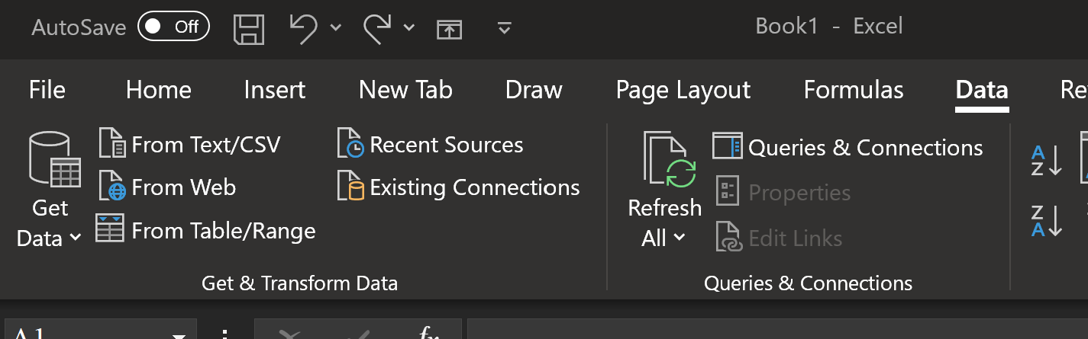
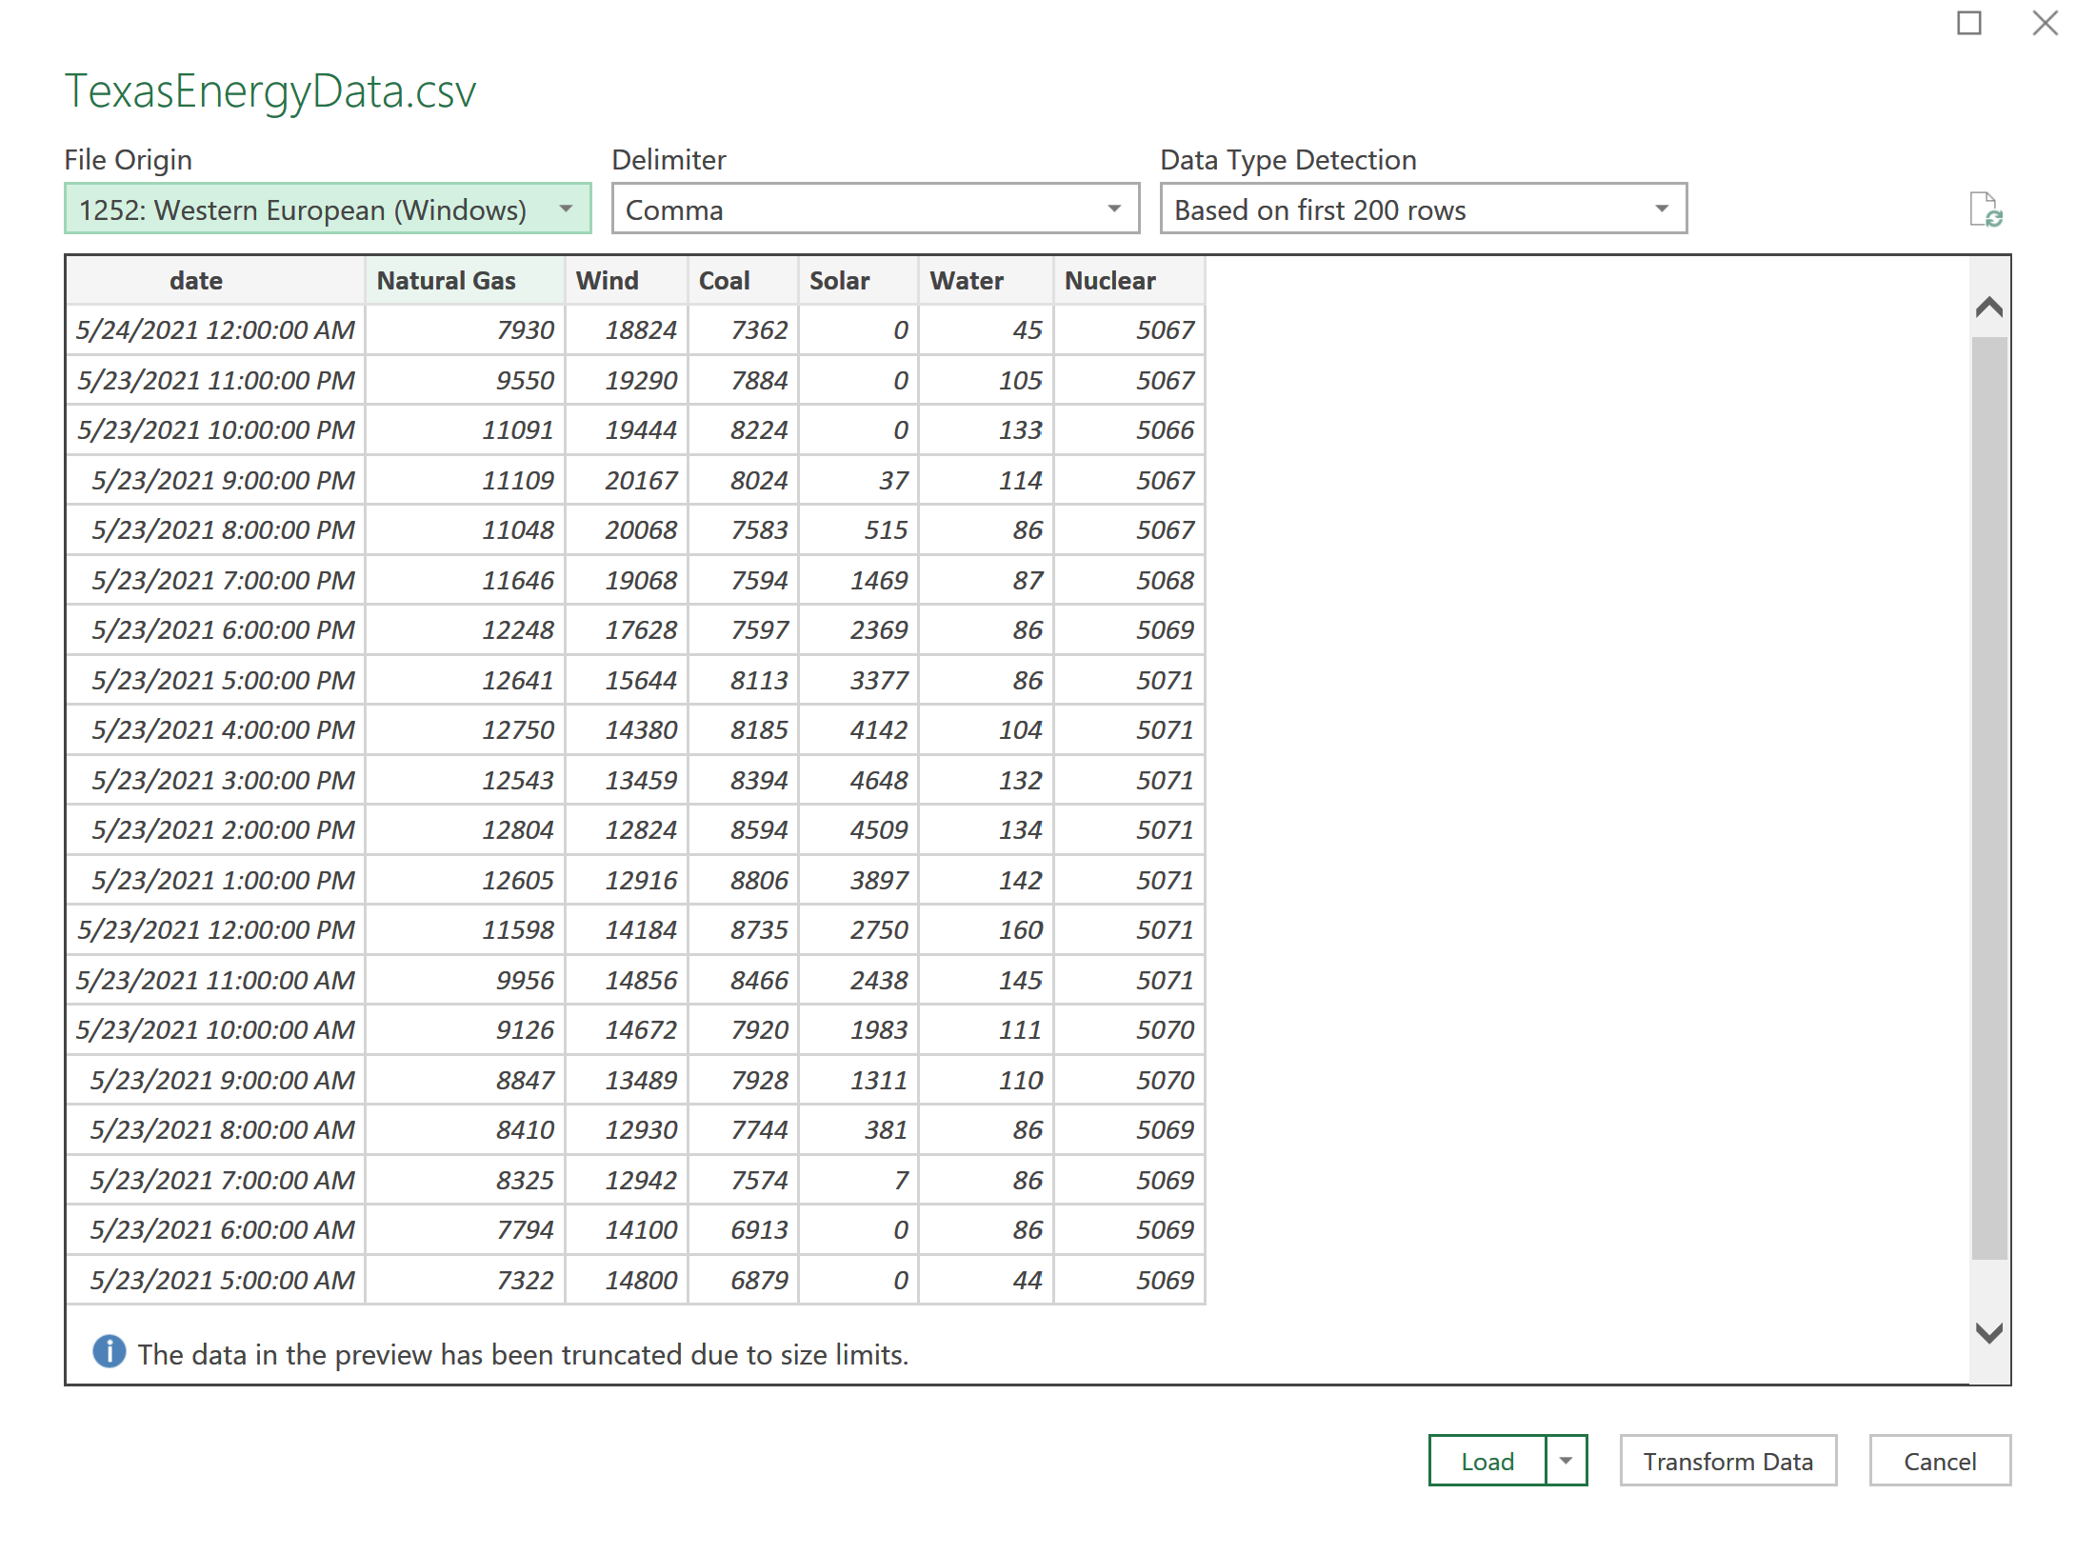
Open Excel > Data > From Text/CSV > Locate the File you want > Import > Load
The Delimiter: Most common is the comma (CSV = comma-separated values)

Slide 67
Categorical?
Numeric?
Continuous?
Ratio?

Slide 68
Central Tendency
=AVERAGE()
=VAR()
=MEDIAN()
=MODE()
=COUNTCOL()
=SUMCOL()
=COUNTROW()
=SUMROW()
Notes:
https://fivethirtyeight.com/features/police-misconduct-costs-cities-millions-every-year-but-thats-where-the-accountability-ends/

Slide 69
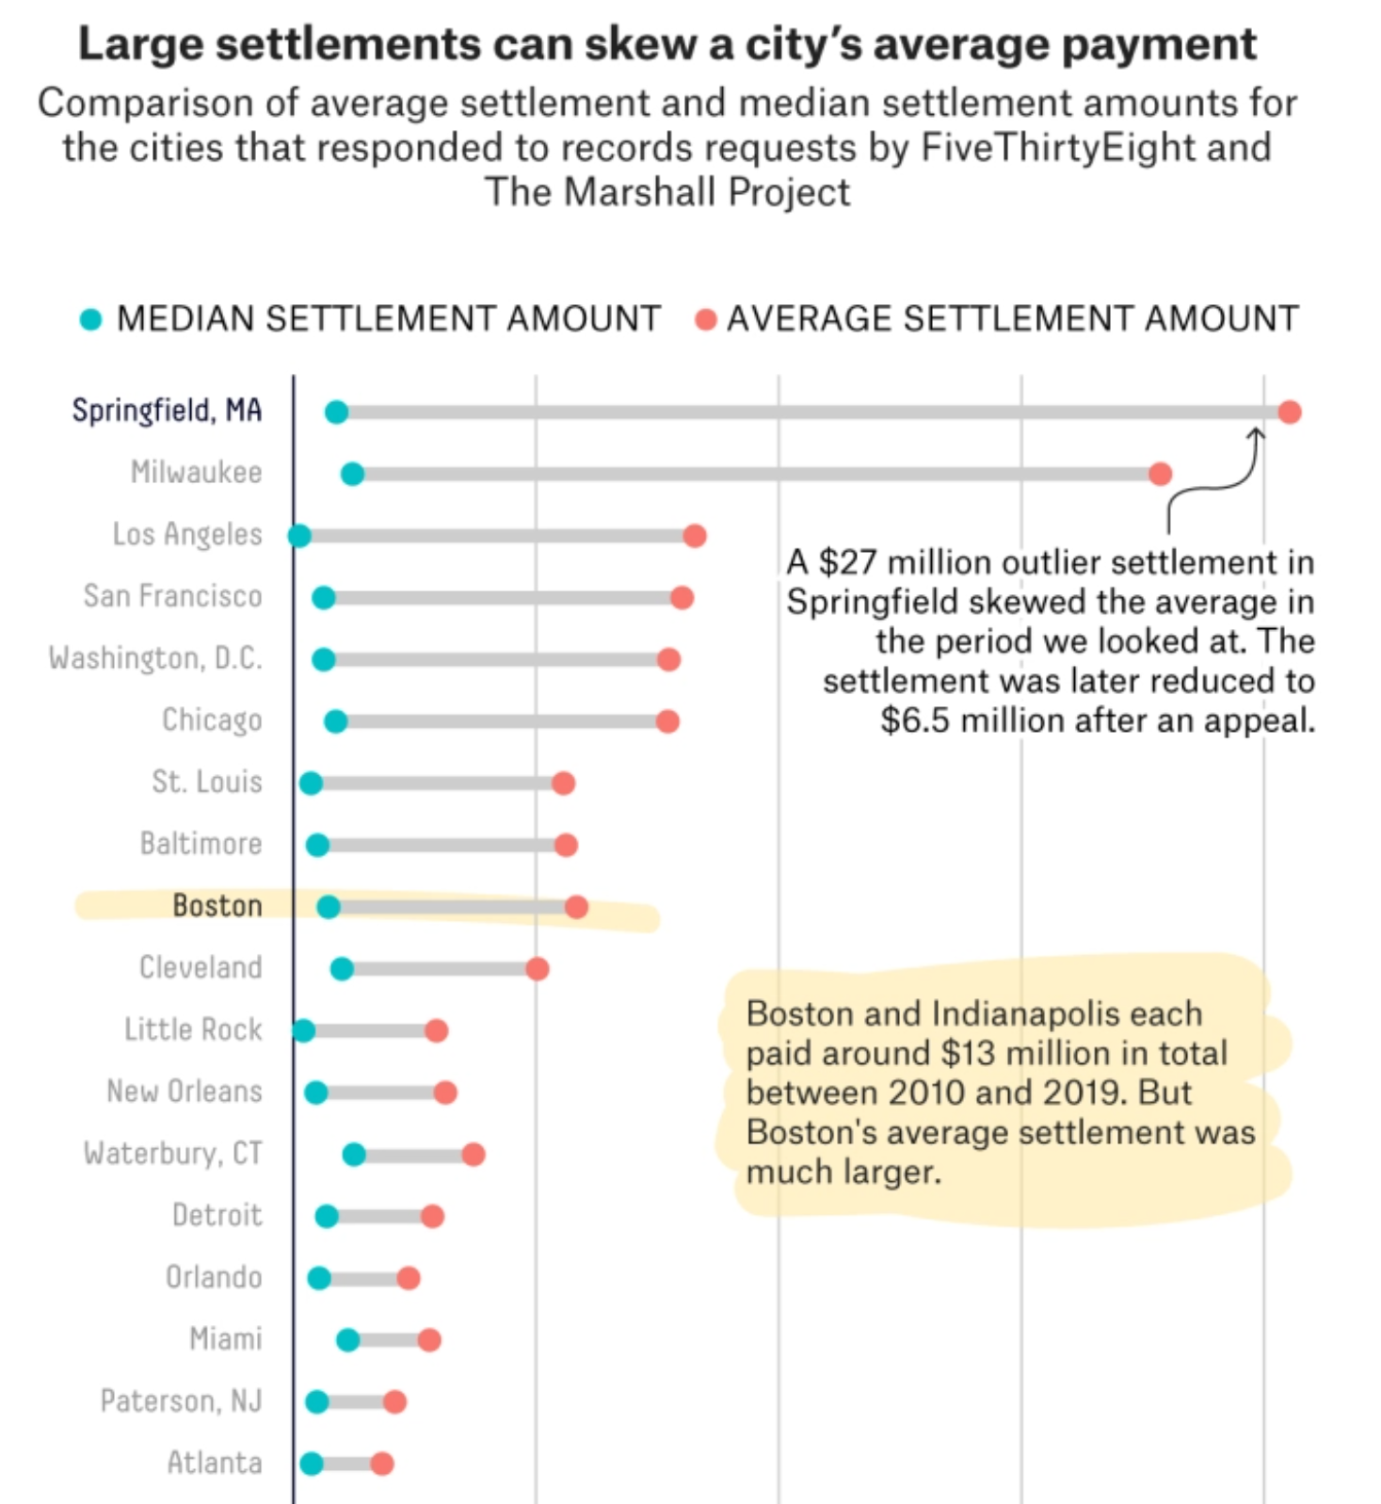
Measuring the Middle
Notes:
Mean, Median, Mode

Slide 70
Dispersion and Deviation
Standard deviations describe Dispersion
How is the data dispersed around the mean
Low standard deviation – values are clustered close to the mean
High standard deviation – values are spread out away from the mean
A “normal” distribution looks like the classic bell curve

Slide 71
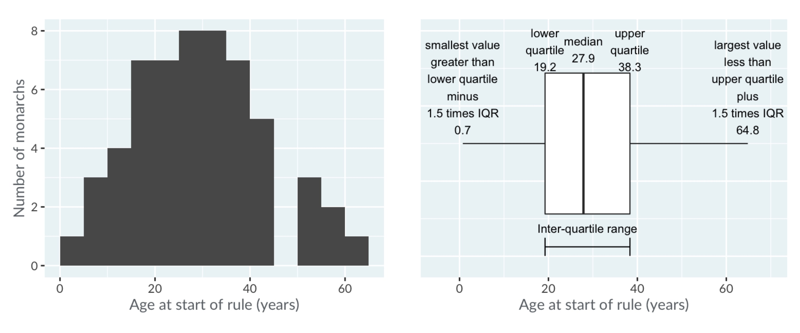
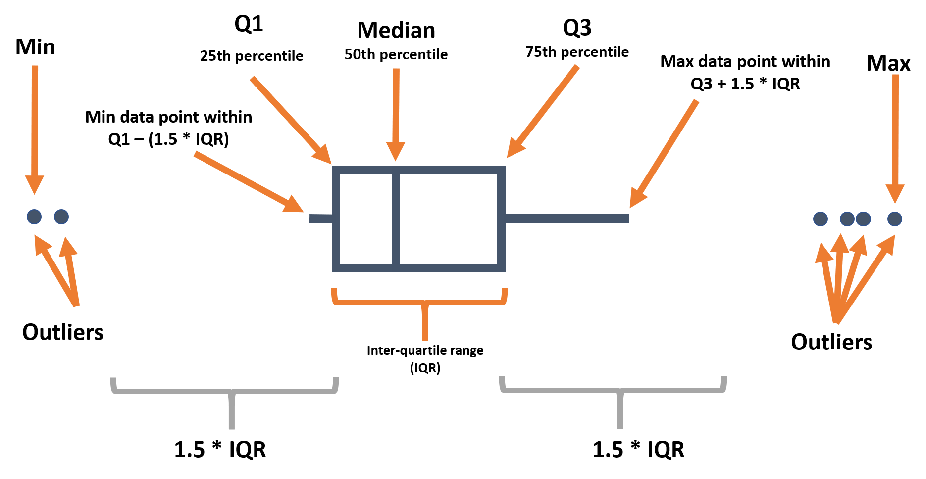
Boxplots

Slide 72
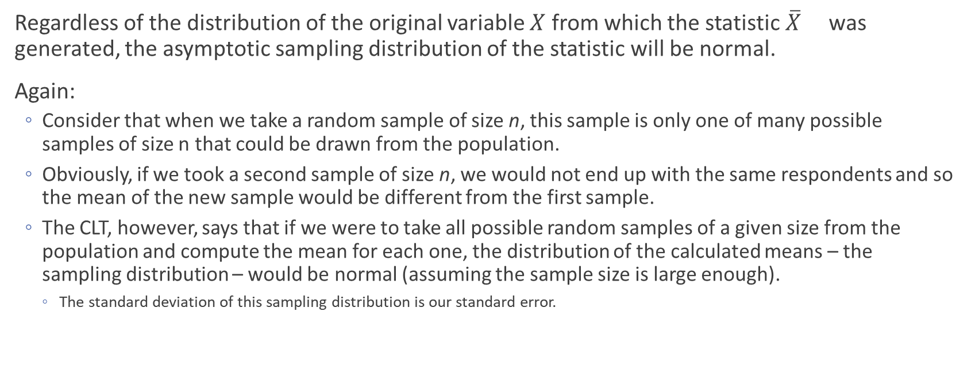
Central Limit Theorem
Regardless of the distribution of the original variable $X$ from which the statistic $\overline{X}$ was generated, the asymptotic sampling distribution of the statistic will be normal.
Again:
Consider that when we take a random sample of size n, this sample is only one of many possible samples of size n that could be drawn from the population.
Obviously, if we took a second sample of size n, we would not end up with the same respondents and so the mean of the new sample would be different from the first sample.
The CLT, however, says that if we were to take all possible random samples of a given size from the population and compute the mean for each one, the distribution of the calculated means – the sampling distribution – would be normal (assuming the sample size is large enough).
The standard deviation of this sampling distribution is our standard error.
Notes:
From Siciliano’s notes

Slide 73
Central Limit Theorem
Regardless of the distribution of the original variable $X$ from which the statistic $\overline{X}$ was generated, the asymptotic sampling distribution of the statistic will be normal.
Again:
Consider that when we take a random sample of size n, this sample is only one of many possible samples of size n that could be drawn from the population.
Obviously, if we took a second sample of size n, we would not end up with the same respondents and so the mean of the new sample would be different from the first sample.
The CLT, however, says that if we were to take all possible random samples of a given size from the population and compute the mean for each one, the distribution of the calculated means – the sampling distribution – would be normal (assuming the sample size is large enough).
The standard deviation of this sampling distribution is our standard error.

Slide 74
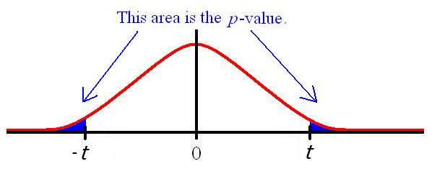
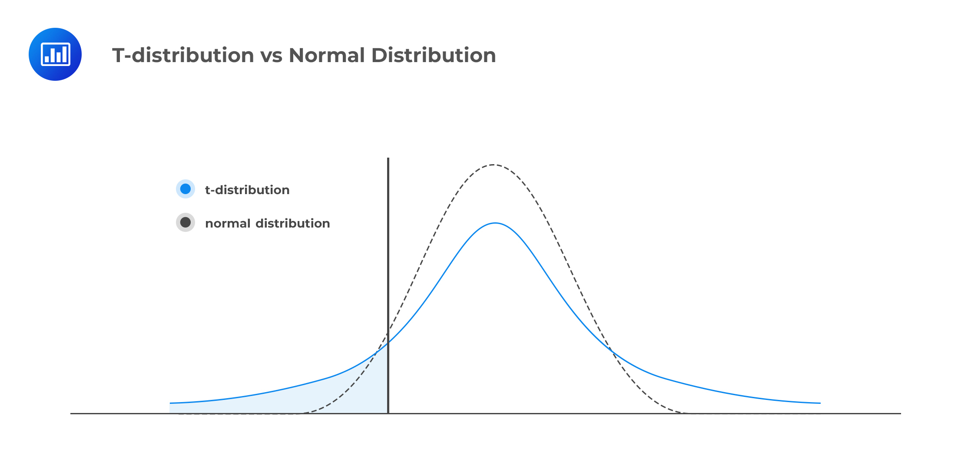
The larger the sample size, the more “normal” the t distribution becomes
=> the areas in the tails shrinks
Smaller tail => less of the distribution falls outside of the confidence interval at set confidence levels.

Slide 75
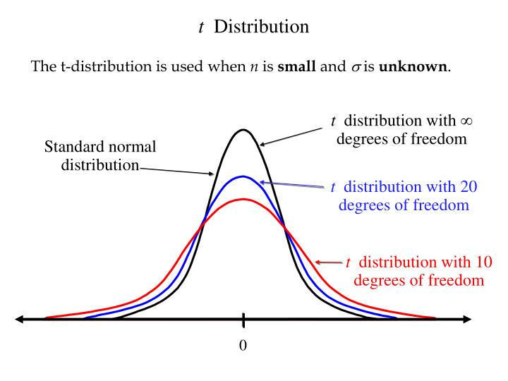
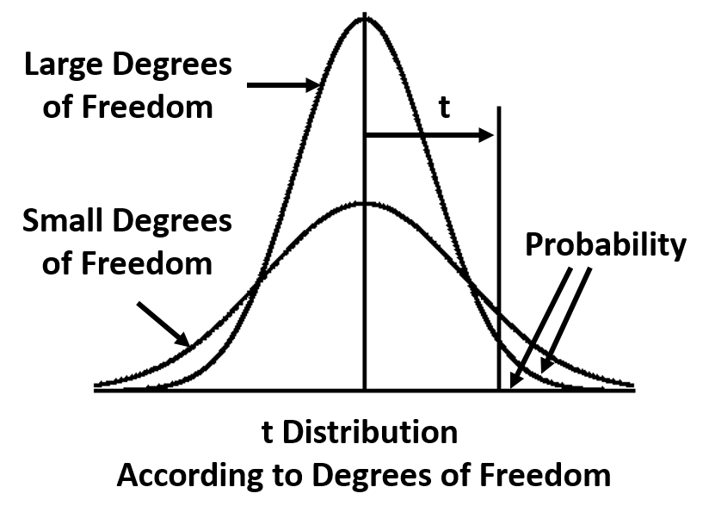
Larger sample size
More degrees of freedom
More normally distributed (the curve becomes taller and skinnier)
Ultimately can become more confident that your results didn’t happen by chance

Slide 76
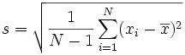
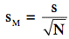
Example: City residents have been asked to report the number of community organizations of which they are members (e.g., churches, PTAs, civic organizations, etc.). Below is are the values observed for a sample of 20 cases for this variable.
1, 2, 2, 3, 3, 3, 4, 4, 4, 5, 5, 5, 5, 6, 6, 6, 7, 7, 8, 8
Calculate the following:
N (sample size)
Mode
Median
Mean
Sample standard deviation
Range
Minimum and maximum
Standard error of the mean
Draw a histogram of the distribution

Slide 77
1, 2, 2, 3, 3, 3, 4, 4, 4, 5, 5, 5, 5, 6, 6, 6, 7, 7, 8, 8
N (sample size): Number of observations ➔ N=20
Mode: Most frequent value ➔ Mode =5
Median: Middle value ➔ Median = 5
1, 2, 2, 3, 3, 3, 4, 4, 4, 5, 5, 5, 5, 6, 6, 6, 7, 7, 8, 8
Mean = Average ➔
(1+2+2+3+3+3+4+4+4+5+5+5+5+6+6+6+7+7+8+8)=94/20=4.7

Slide 78
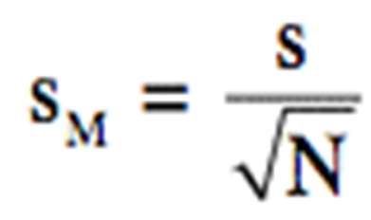

Sample standard deviation
(1-4.7)²=13.69
(2-4.7) ²=7.29
(2-4.7) ²=7.29
(3-4.7) ²=2.89
(3-4.7) ²=2.89
(3-4.7) ²=2.89
(4-4.7) ²=.49
(4-4.7) ²=.49
(4-4.7) ²=.49
(5-4.7) ²=.09
(5-4.7) ²=.09
(5-4.7) ²=.09
(5-4.7) ²=.09
(6-4.7) ²=1.69
(6-4.7) ²=1.69
(6-4.7) ²=1.69
(7-4.7) ²=5.29
(7-4.7) ²=5.29
(8-4.7) ²=10.89
(8-4.7) ²=10.89
Sum=76.2
S=sqrt((1/19)*76.2)=2.0026…
1, 2, 2, 3, 3, 3, 4, 4, 4, 5, 5, 5, 5, 6, 6, 6, 7, 7, 8, 8
Minimum and maximum: 8 and 1
Range (8-1)=7
Standard error of the mean = 2.00/(sqrt(20))=.447

Slide 79
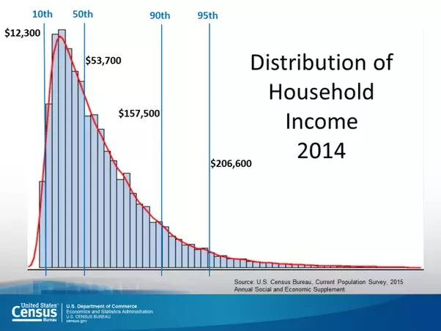
Create a new one in R with current data from ANES?

Slide 80
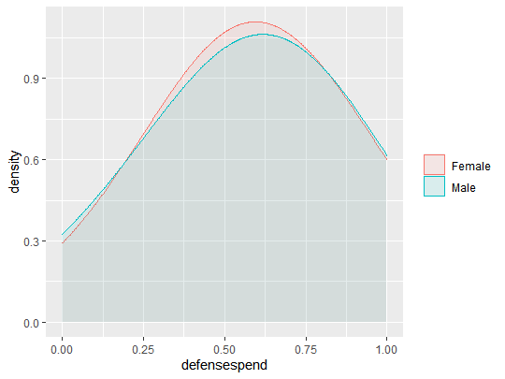
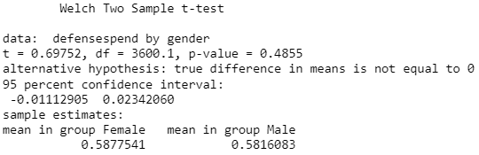
Preferences of spending on defense by gender
Notes:
Interpretation: there is not a statistically significant difference between genders on preferences for defense spending.

Slide 81
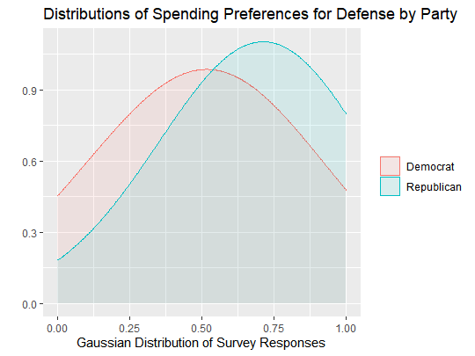
Preferences for Spending on Defense for Democrats and Republicans
Notes:
There is a statistically significant difference in the preferences for spending on defense between democrats and republicans.

Slide 82
Practice Questions
What was the maximum number of megawatts produced by coal during one hour?
On average, what percent of ERCOT’s total megawatts come from natural gas each day? From wind?
Avg gas drops 7,407 MWh. Wind drops 2,535 MWh
What was the percent change from February 15 to February 16th for each power source?

Slide 83
Research Question: V161178 vs. V161181
Research Question: Is there a difference in spending level preferences for defense spending and spending on social services?
V161178: 7pt scale spending on services self-placement
Government should provide fewer services → 7. Government should provide more service.
V161181: 7pt scale defense spending self-placement
Government should decrease defense spending → 7. Government should increase defense spending
Notes:
Data from ANES 2016, available for download online.

Slide 84
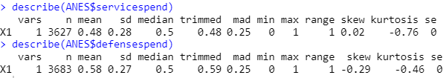
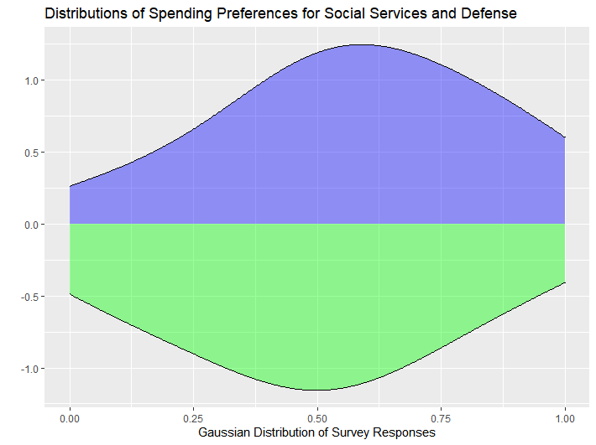
Notes:
In future courses, you’ll learn how to test if they are different enough that it is unlikely to happen by chance (statistically significant difference).

Slide 85
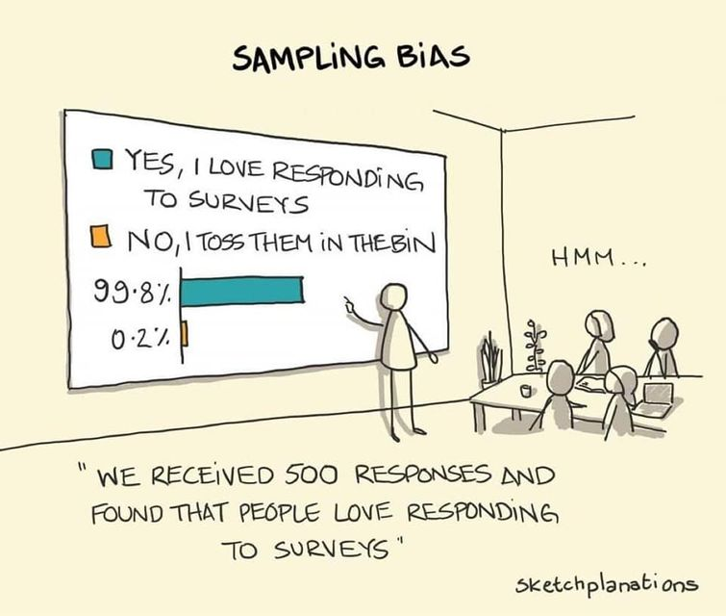
Notes:
Add to whenever we are talking about surveys

Slide 86
Week 4 – Calculating Change

Slide 87
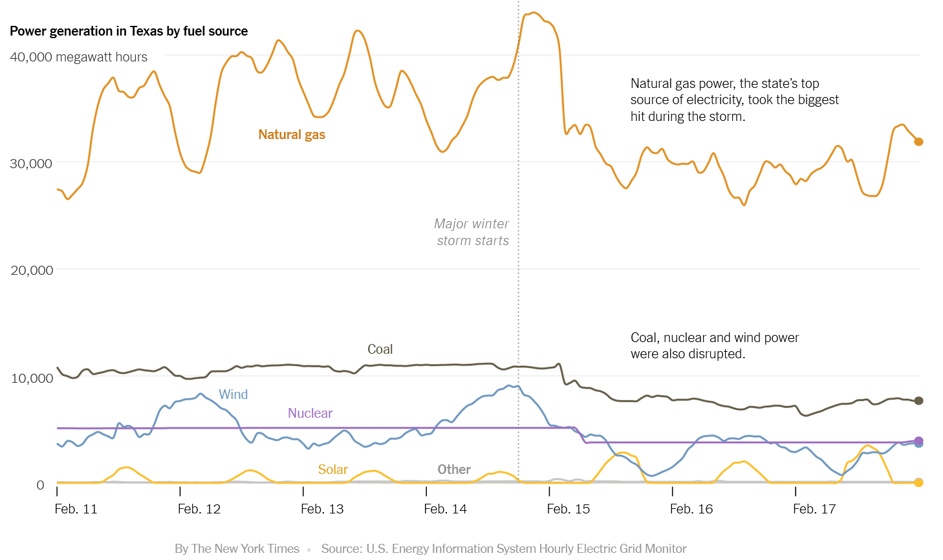

Slide 88
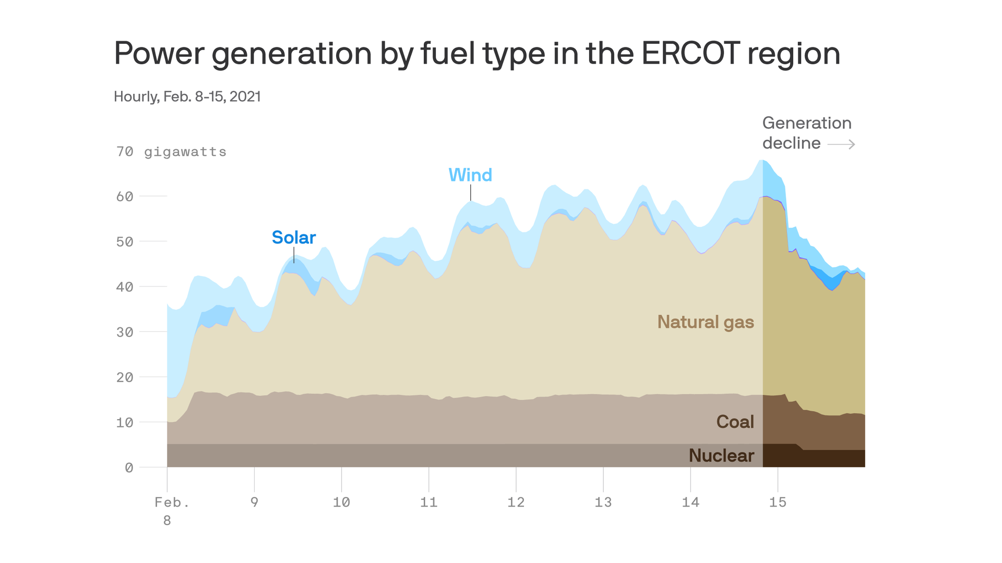

Slide 89
Cleaning Dates

Slide 90
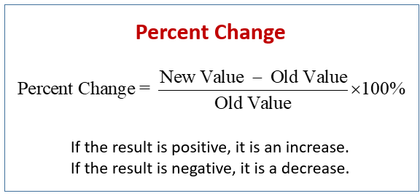

Calculating Change

Slide 91
Percentage vs. Percentage Points
Percentage
A price decrease of 100% means the price has dropped to $0. A decrease of 200% means someone is now paying you the same amount you used to pay them.
Percentages have to be applied to the same baseline in order for them to be equivalent.
Cutting the salary of a position by 50% can not be restored by increasing it by 50%.
A 50% decrease of $1000 = $500.
A 50% increase of the $500 is only $750.
Percentage Points
If interest rises from 3% to 4%, it has increased 1 percentage point, OR 33% (1 percentage point is 1/3 of the original baseline of 3 percent)
If interest falls from 4% to 3%, it has decreased by 1 percentage point, OR 25% (1 percentage point is 1/4 of the baseline of 4.
Be careful when reading about or using these terms to describe something!

Slide 92
Percentages
What percentage of a school districts budget is spent on salaries, maintenance, instructional materials, etc.?
What percentage of instructional spending goes towards different subjects(band, science, sports, etc.)?
Percent of GDP spent on health care
Percent of a city budget spent on policing
Two vastly different cities may have very different budget structures and revenue sources. It may be more meaningful to compare the amount spent on policing per citizen.

Slide 93
Sales tax increases from 4% to 6%.
Increases by 2 percentage points
It also increased by 50% (increased 2 / baseline 4)
To make it sound small, call it a 2 percentage point increase.
To make it sound large, people may say that the sales tax increased 50%

Slide 94
Meaningful Comparisons
Breitbart headline – proclaimed that 2,139 of the DREAM Act recipients had been convicted or accused of crimes against Americans.
In comparison….
~700,000 people held DACA status concurrently (at the same time) and so far, nearly 800,000 people have been granted DACA status at some point in time.
0.3 percent of all DACA recipients have been accused of crimes (1 in 300)
US citizens have twice as high of a chance of being arrested (0.75 percent) as DACA recipients are to have been accused of a crime.
About 8.6% of all American citizens have been convicted of a felony at some point in their lives.
However, DACA recipients are younger and have had less time to commit crimes compared to all Americans. BUT 30% of Americans have been arrested for something other than traffic violations by age 23.
So even if Breitbart’s headline was correct, without context they are not meaningful or honest
Notes:
2,139 who lost DACA status when “Calling Bullshit” was published due to felony or misdemeanor convictions, arrests, or suspected affiliation. – 85
To be eligible for DACA status, one must not have been convicted of a felony, or significant misdemeanor, or three misdemeanors of any kind.

Slide 95
Relative Risk
If it’s a bad flu year (when the vaccine doesn’t match the annual flu variety), the flu rate is around be 4% for unvaccinated and 1% for vaccinated people.
During a good flu year, when the vaccine works the most effectively against the flu, 2% of unvaccinated people get sick and 1% of vaccinated people catch the flu.
A person online was questioning the importance of the influence vaccine because when they are mismatched, only 1 in 100 people benefited from the vaccine effort. It only reduces influenze cases by 1 less person per 100 people.
If we think the flu vaccine is helping only 1 in 100 people, is it worth it? Well compared to 2% of people getting the flu if they are unvaccinated, 50% of the number of people will have the flu.
A 1 percentage point decrease = a 50 percent decrease in the number of flu cases
Notes:
Calling bullshit pg 89
Since 2010, CDC estimates that the influenze rates have ranged from 3% to 11%.

Slide 96
The use of seatbelts drops the annual risk of injury from “only” 2% to 1%. This also decreases them by half.
2000: 12.9% of the US population was Black but 41.3% of the inmates in US jails were Black.
2005: 38.9% of all inmates were black.
At first glance, this seems like progress, but unfortunately the number of Black individuals in US jails increased by more than 13%.
The number of whites in US jails increased by 27%. This shifted the overall percentages of inmate demographics.
In 2005, the raw number of people in jail increased, but the proportion of inmates who are Black decreased slightly compared to what it was in 2000 (there are still an extremely disproportionate number of Black individuals in jail).
Notes:
Shows issue of comparisons that involve fractions or percentages.
Changing denominators hide changes in numerators.
The numerator, number of jailed Black Americans, increased a lot, but the denominator increased by an even larger proportion. Pg 90.

Slide 97
Scott Walker claimed in June 2011 that 50% of the nation’s job growth had occurred in Wisconsin.
But…. Many US states lost jobs overall, while others gained, which almost balanced out. There was a net increase of only 18,000 jobs in the entire United States. Wisconsin had a net growth of 9,500 jobs that year, so he claimed that Wisconsin job growth was over half of the size of the country’s net growth.
Despite his claim, only a small fraction of the total jobs created in the country were created in Wisconsin.
Notes:
Calling Bullshit, pg 92

Slide 98
Lab

Slide 99
Wednesday Lab
Data: World Inequality Database
Cleaning List:
Delimited file -> Excel table
Reformat Text -> Numbers

Slide 101
Creating Variables

Slide 102
Index and Scales

Slide 103
Unit of Analysis

Slide 104
Correlation

Slide 105


Slide 106


Slide 107
Correlation
The extent to which two continuous (interval or ratio level) variables are related
A relationship exists when knowing the value of one variable is useful in predicting the value of a second variable
Linear relationship – change in one variable corresponds to change in the other variable (same across the range of the variable)
Nonlinear relationship – change in one variable corresponds to change in the other variable (not the same across the range of the variable)

Slide 108
How This Thing Changes with That Thing
Every time we adjust one thing, another thing changes.
When children eat a nutritional breakfast five days a week, test scores increase by three points.
These two things are totally interrelated.
Based on the current pattern, we predict moderate growth over the next quarter.
The more I exercise, the better I feel.
These outliers don’t fit the pattern and may be worth investigating

Slide 109

Correlation
Positive association – as the value on one variable goes up, the value on the other variable goes up
Negative association – as the value one variable goes up, the value on the other variable goes down

Slide 110


Slide 111
Examples of curvilinear relationships:
Watering and plant growth
Amount of money spent per student and student performance (diminishing returns)
Income and age often curvilinear relationships
Income – diminishing returns (effect of difference between income of $10k and $11k not the same as difference between $100k and $101k)
Age – cognitive ability, attitude strength

Slide 112
Strength of correlation or relationship
Ranges from -1 to +1
A correlation of -1 or +1 between x and y would mean that knowing the value of a case on x would allow you to perfectly predict the case’s value on y
Value of 0 means no association

Slide 113
What affects the strength of a relationship?
The actual strength of the association.
The reliability of the measures being used:
Measurement error = True score – Observed score
Systematic error – e.g., social desirability bias
Random error – e.g., random contextual factors
Use of multiple measures
Reliability – Chronbach’s alpha measure of reliability
Number of items
Degree of relatedness across items

Slide 114


Slide 115
Correlation versus regression:
Correlation
No assumption about IV and DV
Typically used to describe the relationship between two variables
Regression
Identifies one variables as the DV and one (or more variables as IVs or control variables)
Can be used to test the effects of multiple independent variables on a dependent variable.
Parametric – ordinary least squares regression, but many, many variants
Most more advanced analysis techniques are extensions of regression
Correlation between two variables = Bivariate regression between same two variables
Bivariate regression
produces regression coefficient rather than correlation coefficient
Unstandardized regression coefficient is the amount of change in the dependent variable that corresponds to one unit of change in the independent variable

Slide 116

Correlation - Excel
Highlight the two columns you want to plot
Add labels,
Add SOME labels for outliers or to highlight key datapoints
- Right click “Add Data Label”, semi transparent label and select Format data labels – Click inside menu with paint bucket
Summary Sentence:
Notes:
Effective Data Visualization pg 335
RadicalMath.org – social justice based data
Data included in Evergreen’s Practice file

Slide 117
Standardardized coefficient
Standardardized coefficient: reporting amount of change in the dependent variable for one unit of change in the independent variable, where both variables are expressed in terms of standard deviations
What this means that this coefficient represents the relationship if you converted both variables to z-scores (which you can do for normally distributed variables). Remember that the z-score represents a values deviation from the mean of the sample in standard deviation units (so z=1.0 represents a score one standard deviation above the mean).

Slide 118
Using Multiple Measures
Can increase the reliability and validity of measures
Multiple ways that measures can be combined
Often multiple items in a scale (e.g., self-esteem; extroversion)
Most commonly averaged into an index
Preliminary step → assess scale reliability
Do the multiple items really assess the same underlying construct or idea?

Slide 119
Index vs. Scale
Scale:
Likert scale is the most common
Ex.) Strongly Disagree/Disagree/Neither Disagree or Agree/Agree/Strongly Agree
Index:
Multiple variables that reflect the same concept, combined into one variable
Creating an Index:
Make sure variables run in same direction, ideally low values mean lower levels of something
Add variables together.
Ex.) 5 variables that each have five values create an index that can have a range from:
5 to 25 OR 1 to 5 OR 0 to 1
Notes:
Likert scale: Fogarty pg. 62
5 to 25
- From just adding the values for all 5 selections. If they chose 5 for the 5 questions, then they have score of 25. If they chose 1 for all 5 questions, then they have a score of 5. If they chose 4 for all 5 questions, then they have a score of 20. etc.
OR 1 to 5
Add them all up and then divide by 5 to get an average
Easy to compare index to original questions
OR 0 to 1
- Subtract 1 so all responses are between 0 and 4
Add them all up and then divide by 20 to get their score on a range of 0 to 1.
Useful for regression to have all variables only have a range of 0 to 1.

Slide 120
Validity & Reliability
Construct Validity
Should these items be combined?
Is there theory or previous research saying the items measure an underlying construct?
Racial resentment example index in future slides
Measurement Reliability
Alpha coefficient for reliability!
How much do the items “agree” with each other?
Notes:
Just because something is highly correlated, does not mean that the items should be combined into an index. Examples on next slides.

Slide 121
Government Trust Index (excel

Slide 122
Data Visualization

Slide 123

Summary Tables

Slide 124
Good and Bad examples

Slide 125
Create multiple graphs from the same data

Slide 126
Merging and Common Identifiers

Slide 127
Vlookup()

Slide 128
Dashboards and Communicating Information

Slide 130
PPOL 105: Intro to R

Slide 131
Installing R and RStudio
What you need:
http://www.cran.r-project.org/ ← Download R (Free version)
http://www.rstudio.com/download ← Download Rstudio (Free version)

Slide 132

Environment / History
File Viewer / Editor
Files/Plots/etc.
Console
Notes:
Each time R is opened, a new “Session” starts. You can change the color scheme and layout in Tools > Global Options > Appearance or View > Pane Layout > Arrange the way you want.
The file viewer. Here you can write your code in a script file for safekeeping and reuse or look at your data in spreadsheet format. When you want to look at more than one file at a time, you can view them in a separate window.
The console. This is where you enter code and see the output. You can either type out your code here or highlight code in the file viewer and use a keyboard shortcut to have it automatically entered.
The environment viewer. This just shows you a list of all the objects that are currently in R’s environment..
Files/Plots/Packages/Help. Does a wide range of things and it is customizable.

Slide 133
Each time R is opened, a new “Session” starts
The file viewer. Here you can write your code in a script file for safekeeping and reuse or look at your data in spreadsheet format. When you want to look at more than one file at a time, you can view them in a separate window.
The console. This is where you enter code and see the output. You can either type out your code here or highlight code in the file viewer and use a keyboard shortcut to have it automatically entered.
The environment viewer. This shows you a list of all the objects that are currently in R’s environment. Data frames, objects, factors, anything you create or import
Files/Plots/Packages/Help. Does a wide range of things and it is customizable.

Slide 134
Open Datafile
Open file in R
Can use either File > Import > Select Data Type > Select Data File
Can type the command read_dta()
ANESdf <- read_dta("anes_timeseries_2016_Stata13.dta")
If the file is in your workspace
Otherwise, include the whole path to the file location, see below
ANESdf <-read_dta("C:\Users\username\Desktop\folder\PA402\anes_timeseries_2016_Stata13.dta")
Reads the .dta file and stores it as a new data frame in R, named ANESdf.
Name it something short but descriptive
Dataframe should now exist in the R Environment tab. Click it. What do you see?
Notes:
Mac users do not need the .dta extension at the end of the file name !!

Slide 135

Notes:
File > Import > From Stata> Browse for file you want
You can rename it in this interface too in the “Import Options” area. I did not do that in this image.

Slide 136
Making RStudio Work: Install Packages
install.packages(“packagename”) #installs on computer- only need to do this once
library(“packagename”) # loads the package into your workspace
install.packages(“tidyverse”) #contains dplyr, ggplot, tibble, readr, tidyr, purr
install.packages(“haven”) #can read SPSS and Stata files.
library(“tidyverse”)
library(“haven”)
Notes:
Fogarty pg 17

Slide 137

You can also use menus to important data files:
Can import multiple file types
.csv or .xlsx
.sas
.sav
Text
Or Open File → the file you want to use
Notes:
You can do this, but it doesn’t always work the way you want or only works for certain file types.

Slide 138

Types of Objects: Vectors, Matrices, and Data Frames
Vector = one-dimensional collection of data, can be a row OR column.
Data Frame = a type of matrix. Think of it like an excel file.
Matrix = combination of columns and rows. At least 1 of each.
Data sets are most often organized with variables in columns (ID number, age, evaluation of President’s performance, etc.) and unit of analysis (people, organizations, observations) in the rows.
Notes:
Vector = one-dimensional collection of data, can be a row OR column.
Matrix = combination of columns and rows. At least 1 of each.
Data Frame = a type of matrix. Think of it like an excel file.
Columns of a data frame are variables

Slide 139

Types of Data & Levels of Measurement
Nominal = logical (binary), factor (categorical)
No Order (ex. race, religion, etc.). Numbers assigned don’t have actual meaning
Ordinal = numeric
has general sense of increasing or decreasing order, but the distances between categories aren’t meaningful
Ex. 1 = high school diploma, 2 = undergraduate degree, 3 = masters degree
Number of years to get each one are all different
Not a form of measurement
Notes:
Discussed more in Week 3

Slide 140
Levels of Measurement: Interval vs. Ratio
Interval = numeric
Has order, Distance between numbers has meaning, 0 is arbitrary
Ex. Temperature in C or F, feeling thermometer survey questions
Ratio = numeric
Same as interval, but 0 implies an attribute does not exist
Ex. Movement of 0 mph, salary of $0,
Not a form of measurement
Notes:
Week 3

Slide 141
Factors, Levels, Values, and Labels
dataframe$variable <- factor(dataframe$variable, levels = 1:5 , labels = c( 'Excellent' , 'Very Good' , 'Good' , 'Fair' , 'Poor’ ))
# levels = the number of options for each variable
Like a multiple choice test (A, B, C, D or 1,2, 3, 4)
# labels = the word that is glued to the value or level of each option for a variable
Describes the variable, levels, or values
# values = numbers that would be used for calculations
# factors = kind of like a paperclip holding together the variable, levels, labels, and values

Slide 142

a is an object that is a vector, only contains one type of information. Either a word or a number.
a.fact is an object that is a factor, it contains multiple types of information for each variable
Factors have attributes where additional information is stored but hidden
Factors have attributes where additional information is stored but hidden.
Attributes can be labels, levels, values, and more ways of describing data in the data frame
https://mgimond.github.io/ES218/Week02a.html for an even more detail explanation with examples
Notes:
The vector, a, is a literally the letters “M”, “F”, and “U” stored as text. Can not do math with character data types.
When the vector is turned into a factor using the as.factor() command, the data type changes to an integer. Factors have multiple attributes which store information, but are hidden from the visible data frame. To view all the attributes of an object, use the attributes() command.
a.fact has two attributes: levels and class.
$levels stores the integer version, 1, 2, and 3 which is linked with the letters F, M, and U.
$class tells you that the object is a factor
https://mgimond.github.io/ES218/Week02a.html for an even more detail explanation with examples.

Slide 143
dplyr
Notes:
In last week’s lab, you learned to:
Open R, RStudio and data file.
Structure of R, Rstudio
Install packages.
This week, you will learn how to recode variables into new variables:
Recode missing values when needed.
Run frequencies of variables

Slide 144


Slide 145
Slides below were originally done using $ coding. Remake with dplyr() code
Keep general ideas but redo.

Slide 146
Useful Functions and Packages
filter() to select cases based on their values.
arrange() to reorder the cases.
select() and rename() to select variables based on their names.
mutate() and transmute() to add new variables that are functions of existing variables.
summarize() to condense multiple values to a single value.

Slide 147
Create a Smaller Dataset: Subset Data
Notice there are 4270 variables in the ANES dataset
You probably don’t need them all.
Keep specific variables
> dataframenew <- subset(dataframeold, select = c(variable1, variable2, variable7:12)
Delete specific variables:
> dataframenew <- subset(dataframeold, select = - c(variable1, variable2, variable7:12)
# deletes variable1, variable2, and variable 7 through 12
Make our dataset smaller: ANES <- subset(ANES, select=-c(V161363a:V168528))
# deletes a bunch of variables/columns listed in the codebook that aren’t main variables
Notes:
Should have 570 variables left
Change to select () in tidyverse

Slide 148
Defining Missing Values = NA in R
Respondents who said “I don’t know” or refused to answer
Respondents who weren’t asked the question (e.g., men for questions about pregnancy)
Often, these responses are given numeric codes that separate them from the substantive values (-9, 99, etc.)
Avoid accidentally including them in analysis!
Numbers typically don’t have actual meaning
They will mess up your calculations unless you change them so that the program recognizes them as “missing” data

Slide 149
Recoding a Categorical Variable
#****gender*****
class(ANES$V161342)
table(ANES$V161342)
ANES$gender <- recode(ANES$V161342, "1='0.Male';2='1.Female'; else=NA")
attr(ANES$gender, "value") <- abs((1-as.numeric(ANES$gender))) #is numeric
table(ANES$gender)
attributes(ANES$gender)
Notes:
Categorical variable: You either are something or you are not something. Mathematical averages do not make sense. Frequently coded as dummy variables.

Slide 150
Descriptive Statistics in R
Notes:
In last week’s lab, you learned to:
Open R, RStudio and data file.
Structure of R, Rstudio
Install packages.
This week, you will learn how to recode variables into new variables:
Recode missing values when needed.
Run frequencies of variables

Slide 151



Look at a Variable: V161115
> ANESdf$V161115 #type in Console
Get output for that variable.
Shows first 1000 observations and information on labels.
Tells R which dataset to use
Tells R which variable you want
Notes:
Unlike other statistics programs, R can use multiple datasets in one analysis. However you need to tell it which dataset to use when you are working with variables. When referencing a variable, you must use the format of dataframe$variable so that R knows what you want. This is another reason to label your variable with short, but useful names.

Slide 152

Attributes: V161115
# type in Console or project file
> attributes(ANESdf$V161115)
$label = label of the question. “Pre” means the question was asked before the election.
$class = haven was the program used to read in the data. Creates a temporary class that allows you to turn it into a more useful “factor.” Normally would want it to say “factor” or “numeric” for an analysis
$labels = description of the variable. Combined information from datafile for numeric values and text descriptions
Notes:
Has attributes: $value (with just numbers), $label (character data type that describes what the question was), $class (tells you how information is bundled together for the variable and what you can do with the variable)

Slide 153

Frequencies: V161115
> table(ANESdf$V161115)
Shows frequency of observations for each coded option
742 selected the option that was coded 1
8 people were coded as -9.
> mean(ANESdf$V161115)
R sometimes knows to use the numeric part of the label
There are better ways of data management
Is this useful? Does it tell you anything?
Only if you look at the Codebook!
Top row is potential responses coded as an integer.
Bottom row is number of people who selected each potential response.
Notes:
Unlike other statistics programs, R can use multiple datasets in one analysis. However you need to tell it which dataset to use when you are working with variables. When referencing a variable, you must use the format of dataframe$variable so that R knows what you want. This is another reason to label your variable with short, but useful names.
Has attributes: value (with just numbers), label ()

Slide 154

Example from a codebook:
In this case, you would want to recode -8 and -9 as missing values
When you import a file (depending on the file type), it prompts you with an NA blank box
You can enter the values that you want to become “missing” for entire dataset
This is not always an option
Messy data, different file types, etc.
Can also do with code commands
Notes:
There are a lot of ways to deal with missing values. If in doubt, Google it out.

Slide 155
Which responses are coded as missing for V161115?
How else can you figure out if there are missing values for different variables?
THE CODEBOOK! --> V161115 says that -9 is for “Refused” aka Missing
Scroll through the data.frame in the Viewer
Click on View> Show Viewer if it isn’t already open
Do you see 0’s, negative numbers, weirdly large numbers, or NA’s?
If you see NA’s, that is good!
If you see 99, -9, -8, etc., these need to be coded as missing
Notes:
Lets say you don’t have perfectly cleaned data designed to be used in R and you need to know if R recognizes that there is data coded as missing.
V161115 has -9 for refused answers.

Slide 156
Reverse Coding and Change Scale
Reverse direction to be more sensible, “lowest” value = 0
Want:
Poor = 0
Fair = 1
Good = 2
Very Good = 3
Excellent = 4
Absolute value of (1 – variable options)
|1-5| = 4 = Excellent
|1-4| = 3
|1-3| = 2
|1-2| = 1
|1-1| = 0 = Poor
Reversed direction and change scale to range from 0 to 1
Poor = 0/4 = 0
Fair = 1/4 = .25
Good = 2/4 = .50
Very Good = 3/4 = .75
Excellent = 4/4 = 1
R code would be:
usefulVariable <- abs((1-numericVariable)/4)
Notes:
Healthy <- (5-V161115)/5
You can use recode() directly with factors; it will preserve the existing order of levels while changing the values.

Slide 157

What’s the problem with this coding?
It has “refused” coded as -9
-9 → NA
Responses are 1- 5
Want 0-1 for analysis
Want scores to be from “low” to “high”
Flip order of responses
Should end up with a scale of Poor (0) to Excellent (1)
Notes:
It has “refused” coded as -9
-9 → NA
Responses are 1- 5
Want 0-1 for analysis
Want scores to be from “low” to “high”
Flip order of responses
Should end up with a scale of Poor (0) to Excellent (1)

Slide 158


Fixing V161115: Aesthetics
# Run variable frequency
> table(ANESvalues$V161115)
#without labels
> ANESvalues$healthy <- recode(ANESvalues$V161115, "5='1.Poor';4='2.Fair';3='3.Good';2='4.Very Good';1='5.Excellent';else=NA")
#recode from low to high
# -8 and -9 recoded as NA

Slide 159

Fixing V161115: New Scale
> attr(ANESvalues$healthy, "value") <- abs((1-as.numeric(ANESvalues$healthy))/4)
# is numeric; allows mathematical calculations.
# Now it is on scale from 0 to 1 for analysis
Notes:
Usage
na_if(x, y)
Arguments
X Vector to modify
Y Value to replace with NA

Slide 160
Creating Indices
Measurement, Types of Variables, Indices, and Reliability
Notes:
In last week’s lab, you learned to:
Open R, RStudio and data file.
Structure of R, Rstudio
Install packages.
Recode missing values when needed.
Run frequencies of variables
This week, you will learn to
Creat a multi-item scale
Recode them to the same scale
Test alpha coefficient
Combine into an index
Validity
Reliability

Slide 161
Example Index in R: Racial Resentment (ANES 2016)
V152211: Irish, Italians, Jewish and many other minorities overcame prejudice and worked their way up. Blacks should do the same without any special favors.
V162212: Generations of slavery and discrimination have created conditions that make it difficult for blacks to work their way out of the lower class.
V162213: Over the past few years, blacks have gotten less than they deserve.
V162214: It’s really a matter of some people not trying hard enough, if blacks would only try harder they could be just as well off as whites.
All are Likert scales that go from Agree Strongly → Disagree Strongly
BUT do they actually capture positive or negative sentiment?

Slide 162
Scales: Direction Matters!
V162211: Irish, Italians, Jewish and many other minorities overcame prejudice and worked their way up. Blacks should do the same without any special favors.
Strongly Agree = most racist
V162212: Generations of slavery and discrimination have created conditions that make it difficult for blacks to work their way out of the lower class.
Strongly Agree = least racist
V162213: Over the past few years, blacks have gotten less than they deserve.
Strongly agree = least racist
V162214: It’s really a matter of some people not trying hard enough, if blacks would only try harder they could be just as well off as whites.
Strongly Agree = most racist
If you were to combine the observations as they are coded, what would happen?
Notes:
Answer, you’d get a mathematical answer, but any interpretation would not be valid because you have two variables going from least racist -> most racist and two variables going from most racist -> least racist.
V162211 and V162214 need to be flipped in order to make an index of racial resentment!

Slide 163
Reverse Recoding
If you were trying to capture racial resentment with these variables, they must be coded so that the underlying construct is measured in the same direction.
Either flip direction of V162211 & V162214 OR flip V162212 & V162213.
Depending on which variables are recoded, the construct of racial resentment goes from:
most racist → least racist
OR
least racist → most racist.
JUST BE CONSISTENT AND KNOW WHICH DIRECTION YOU CHOSE!

Slide 164


V162211: Irish, Italians, Jewish and many other minorities overcame prejudice and worked their way up. Blacks should do the same without any special favors. => Strongly Agree = most racist
> ANES$resent1 <- recode(ANES$V162211, "5=1; 4=2;3=3;2=4;1=5")
R has already taken care of the missing values – they don’t show up in the table
Make sure values match! Originally, “1. Agree Strongly” had 1110 people select it. It has to match the 5th level that represents higher levels of racial resentment. Check other levels too!
Notes:
# Don't need to label everything when making an index
# You do need to know the direction of coding and its meaning for each variable. Some go high->low, some go low-> high.
### **** Racial Resentment Correlation and Index Creation **** ###
table(ANES$V162211)
# You do need to know the direction of coding and its meaning for each variable. Some go high->low, some go low-> high.
ANES$resent1 <- recode(as.numeric(ANES$V162211), "5=1; 4=2;3=3;2=4;1=5")
#Think of the format this way: What you have = what you want.
table(ANES$resent1)
table(ANES$V162212)
ANES$resent2 <- ANES$V162212
ANES$resent3 <- ANES$V162213
ANES$resent4 <- recode(as.numeric(ANES$V162214),"5=1; 4=2;3=3;2=4;1=5")
table(ANES$resent4)

Slide 165
Another way to recode ANES$resent1 that has labels
# Still format of "Have=Want“ when recoding variables
> table(ANES$V162211)
> ANES$resent1OPTION2 <- recode(as.numeric(ANES$V162211), "1='5.Strongly Disagree';2='4.Disagree';3='3.Neither Agree/Disagree';4='2.Agree';5='1.Strongly Agree’”)
> table(ANES$resent1OPTION2)

Slide 166



V162212: Generations of slavery and discrimination have created conditions that make it difficult for blacks to work their way out of the lower class. => Strongly Agree = least racist
> table(ANES$V162212)
# Note that missing values are taken care of already in table()
> ANES$resent2 <- ANES$V162212
# yes, it is that easy
> table(ANES$resent2)
Make sure values match! Originally, “1. Agree Strongly” had 645 people select it. We didn’t reverse this one, so it is correct.
Notes:
table(ANES$V162212)
# Note that missing values are taken care of already in table()
ANES$resent2 <- ANES$V162212
# yes, it is that easy.
table(ANES$resent2)

Slide 167
Example Index: Racial Resentment Variables
# Look at codebook to determine direction of scales for underlying construct
# Don't need to label everything when making an index
ANES$resent1 <- recode(as.numeric(ANES$V162211), "5=1; 4=2;3=3;2=4;1=5")
ANES$resent2 <- ANES$V162212
ANES$resent3 <- ANES$V162213
ANES$resent4 <- recode(as.numeric(ANES$V162214),"5=1; 4=2;3=3;2=4;1=5")
# check your work to make sure the counts still match those of the codebook.
Notes:
More than one way to label things!

Slide 168
Cronbach alpha reliability test
Cronbach’s alpha is a measure of internal consistency and scale reliability.
Higher values show better scale reliability.
Usually, α > .70 is acceptable.
Before using an index for racial resentment, check the correlation between the variables in the index
> library(psych)
> someindex <- subset(dataframe, select=c(rangeOf:variablesYouWant)) # creates index / mini df
> alpha(someindex) # estimate of reliability for a single scale

Slide 169


Raw_alpha is what we care about
None of the alphas increase when a variable is dropped. Therefore keep the variables.
Notes:
What do the summary statistics mean?
raw_alpha: Cronbach’s α (values ≥ .7 or .8 indicate good reliability; Kline (1999))
std.alpha: this should be similar to raw_alpha (we only need the raw alpha though)
G6: Guttman’s lambda 6 (calculated from the squared multiple correlation or ‘smc’)
average_r: average inter-item correlation (this is used to calculate std.alpha)
mean: scale mean (the mean of the means of all individuals)
sd: scale sd
How to interpret ‘Reliability if an item is dropped’?
The overall α (raw_alpha) is .85. Each row refers to each item and has a raw alpha associated—this refers to the overall α when that particular item has been dropped/deleted. For example, the first row refers to resent1, and if it is dropped, the overall α becomes .80, which reflects worse reliability, so we want to keep resent1.
We are checking whether any of these raw alpha values are greater than the overall α of .85; if yes, this means that dropping that particular item will increase the overall α of the scale.
The other columns of this table refer to how the other statistics will change if that particular item has been dropped/deleted.
How to interpret ‘Item statistics’?
raw.r: correlation between the item and the total score from the scale (i.e., item-total correlations); there is a problem with raw.r:, the item itself is included in the total—this means we’re correlating the item with itself, so of course it will correlate (r.cor and r.drop solve this problem)
r.drop: item-total correlation without that item itself (i.e., item-rest correlation or corrected item-total correlation); low item-total correlations indicate that that item doesn’t correlate well with the scale overall
r.cor: item-total correlation corrected for item overlap and scale reliability
mean and sd: mean and sd of the scale if that item is dropped
All items should correlate with the total score, so we’re looking for items that don’t correlate with the overall score from the scale. If r.drop values are less than about .3, it means that particular item doesn’t correlate very well with the scale overall.
How to interpret the final frequency table?
This table tells us what percentage of people gave each response to each of the items (i.e., if you have a 5-point scale, then it tells you how many percent of responses were 1, 2, 3, 4, or 5).
This helps you check the distribution of responses and whether everyone is giving the same responses (which will lead to low reliability).

Slide 170
Options if alpha coefficient is small:
1. Drop item(s) if that improves alpha to acceptable levels.
2. Look for other items to include in index to improve.
3. Consider as separate measures (not of the same underlying construct).
4. Combine them into an index and report it, even if it less than 0.7.

Slide 171

Raw alpha is what we care about
> resentment2 <- subset(ANES, select=c(resent1, resent2, resent3, resent4, healthy))
If the “healthy” variable is dropped, the alpha coefficient increases to 0.85.
This implies that “healthy” doesn’t measure the same construct as the other variables.
Notes:
Slide shows what happens if a variable that doesn’t fit into the construct is added into the index. Perceptions of health do not logically tap into the same construct as racist beliefs.
How to interpret ‘Reliability if an item is dropped’?
The overall α (raw_alpha) is .77 for the “resent” variables with the healthy variable. Each row refers to each item and has a raw alpha associated—this refers to the overall α when that particular item has been dropped/deleted. For example, the first row refers to resent1, and if it is dropped, the overall α becomes .68, which reflects worse reliability, so we want to keep resent1.
We are checking whether any of these raw alpha values are greater than the overall α of .77; if yes, this means that dropping that particular item will increase the overall α of the scale.
The other columns of this table refer to how the other statistics will change if that particular item has been dropped/deleted.

Slide 172
Lab Activity: Government Trust
We want to create an index to measure the level of trust in government How would you recode each of those so that higher numbers indicated greater trust?
Use V161215, V161217, V161218, V161219
2. Use alpha reliability coefficient approach to test whether those items can be combined into an index. Does dropping any of the items improve the alpha coefficient?
3. Create an index using the variables.
Notes:
Think about why it is possible to still have a low construct validity even if you find a large alpha coefficient.
Hint to find variables quickly in codebook:
CTRL+F for variable name

Slide 173
Government Trust Index
V161215: How often can you trust the federal government in Washington to do what is right?
V161217: Do you think that people in government waste a lot of the money we pay in taxes, waste some of it, or don’t waste very much of it?
V161218: How many of the people running the government are corrupt?
V161219: Generally speaking, how often can you trust other people?
Notes:
Low Levels of Trust -> High levels of trust.
Do any variables need to be reverse coded?

Slide 174

How to obtain descriptive statistics
describe() reports means, standard deviations, medians, min, max, range, skew, kurtosis and standard errors for integer or real data.
Non-numeric data, although the statistics are meaningless, will be treated as if numeric (based upon the categorical coding of the data)
Just because you can do math with the data, doesn’t mean you should
Notes:
x
A data frame or matrix
na.rm
The default is to delete missing data. na.rm=FALSE will delete the case.
interp
Should the median be standard or interpolated
skew
Should the skew and kurtosis be calculated?
ranges
Should the range be calculated?
trim
trim=.1 – trim means by dropping the top and bottom trim fraction
type
Which estimate of skew and kurtosis should be used? (See details.)
check
Should we check for non-numeric variables? Slower but helpful.
fast
if TRUE, will do n, means, sds, min, max, ranges for an improvement in speed. If NULL, will switch to fast mode for large (ncol * nrow > 10^7) problems, otherwise defaults to fast = FALSE
quant
if not NULL, will find the specified quantiles (e.g. quant=c(.25,.75) will find the 25th and 75th percentiles)
IQR
If TRUE, show the interquartile range
omit
Do not convert non-numerical variables to numeric, omit them instead
head
show the first 1:head cases for each variable in describeData
tail
Show the last nobs-tail cases for each variable in describeData

Slide 175
Recoding Variables
Create dichotomous variables, ordinal variables, groups

Slide 176
Create a Binary Variable from Categorical
We want to create a binary variable that equals 1 if the respondent believes women should never be able to obtain an abortion, and 0 otherwise (coding categories 5, -8, and -9 as NA).
> attributes(tail(ANES$V161232))
$label
[1] "PRE: STD Abortion: self-placement"
$labels
-9. Refused
-8. Don't know (FTF only)
1. By law, abortion should never be permitted.
2. By law, only in case of rape, incest, or woman's life in danger.
3. By law, for reasons other than rape, incest, or woman's life in danger if need established
4. By law, abortion as a matter of personal choice.
5. Other SPECIFY
$class
[1] "haven_labelled"

Slide 177

Create a Binary Variable from Categorical
attributes(tail(ANES$V161232))
table(ANES$V161232)
ANES$abortDummy <- recode(ANES$V161232, "1=1; 2=0;3=0;4=0; else=NA")
table(ANES$abortDummy)
describeBy(ANES$abortDummy, ANES$gender)

Slide 178

Consolidating a Variable’s Categories
ANES$partyid <- ANES$V161158x
ANES$partyid3 <- plyr::mapvalues(ANES$partyid, c(1,2,3,4,5,6,7), c('Democrat', 'Democrat', 'Democrat', 'Independent', 'Republican', 'Republican', 'Republican'))
table(ANES$partyid3)
table(ANES$V161158x)
0. DK; NA; other; refused to answer 968
1. Strong Democrat 9320
2. Weak Democrat 10390
3. Independent - Democrat 5649
4. Independent - Independent 5617
5. Independent - Republican 4772
6. Weak Republican 6790
7. Strong Republican 5592
Notes:
Always create a new variable – do not overwrite old variables (lost data – in your case backup on BB, but not always true).
Will create a new column in your data file – data view (and new row in variable view).
Always keep syntax so you know how you created new variables.

Slide 179

Comparing Groups so far….
describeBy reports descriptive statistics broken down by some categorizing variable (e.g., gender, age, etc.)

Slide 180
Comparing Groups so far….
> table(ANES$healthy, ANES$partyid3)
#Crosstabs of perception of health by party identification
> crosstabs <- xtabs(~healthy+partyid3, data=ANES) #useful for multiple variables
> summary(crosstabs)
partyid3
healthy Dem. Ind. Rep.
1 353 86 302
2 625 164 638
3 606 203 521
4 285 95 220
5 66 30 48
Notes:
Pg 174

Slide 181


Frequencies with percentages
> freq(ANES$gender, na.rm=TRUE, plot=FALSE)
# women make up 52.25% of the respondents surveyed
Notes:
Pg 174

Slide 182
Central Tendency & Variance in R

Slide 183
Comparing Variables
Research Question: Is there a difference in spending level preferences for defense spending and spending on social services?
V161178: 7pt scale spending on services self-placement
Government should provide fewer services → 7. Government should provide more service.
V161181: 7pt scale defense spending self-placement
Government should decrease defense spending → 7. Government should increase defense spending
Notes:
Null hypothesis: There is not statistically significant difference in means.
Alternative hypothesis: There is a statistically significant difference in means.

Slide 184
Example 4

Slide 185


Notes:
ggplot(ANES) +
# Top
geom_density(aes(x = defensespend, y=..density..), adjust=4, fill="blue", alpha=.4) +
# Bottom
geom_density( aes( x = servicespend, y=..density..), adjust=4, fill="green", alpha=.4)+
ggtitle("Distributions of Spending Preferences for Social Services and Defense") +
scale_x_continuous(name = "Gaussian Distribution of Survey Responses")+
scale_y_continuous(name = "")

Slide 186
Example: Correlation between feeling thermometers between feeling thermometer rating of mayor and local city police (0-100)
Pearson correlation coefficient: r=.141
Statistical significance: p-value=.0001
Sample size: N=1993
Pearson correlation coefficients:
Range from -1 to +1
Is unaffected by the scale of the variables (interpretation affected by direction of coding)
Interpreting the “size” of coefficients
Affected by theory
Affected by actual size of effect and also measurement error

Slide 187
The base function for correlations in R is simply cor() followed by the y and x variables.
Pearson’s correlation, which provides a correlation coefficient (r) for a linear relationship; thus it assumes a linear relationship between x and y.
Correlation analysis provides a coefficient that tells us, on average, how much two variables (x and y) move together relative to their respective means.
The sign of r simply tells us whether the relationship is positive or negative
We can also use r to determine the amount of variance explained in our outcome variable from our predictor variable R2 which is called the coefficient of determination.
Notes:
Pg. 281?
We can also test for statistical significance in correlation analysis. This tells us whether the correlation we observe in our sample data is expected to be true in the population. The main caveat is that even if
we find there is a significant correlation, we are only comparing two variables in isolation and not taking into account other factors; more on this in the next chapter. Further, if we have an outcome variable on the interval/ratio level, and particularly if we have a predictor variable on the interval/ratio level, we are better off using linear regression (specifically, multiple regression, as we will in the next chapter) than correlation analysis.

Slide 188
Data visualization

Slide 190
Make a scatter plot
A lot of the code used previously can be re-used for the scatter plot. Two main differences are the following:
Because we now have an additional variable, we need to assign a y = for the aes( ) command within ggplot( ).
Create the plot so that Celery_Eaten will be on the y-axis.
Add (+) a geom_point( ) element instead of geom_hist( )
Also, we will add lines to our plot, representing the mean of each variable. Here’s how we’ll do that:
Add a horizontal line by adding (+) a geom_hline( ) component. This takes the argument yintercept =, which equals the value for where the horizontal line should cross the y-intercept.
Since we want to place this line at the mean of y variable (y¯y¯), we can use the mean( ) function instead of specifying a numeric value directly.
Add a vertical line by following the same structure as above but using geom_vline( ) and xintercept = instead. This vertical line will represent the mean (x¯x¯) of the heights.
Notes:
It’s difficult to get an idea if there’s any relationship by just looking at the data frame. We learn a lot more from creating a plot. Use ggplot to make a scatterplot.

Slide 191

Deviations
Why do we use the deviations? Because we want to know whether the x-values and y-values move together with respect to their means or not. For example, when an observation’s deviation on x is above x¯, will its deviation on y also be above y¯? Using this line of thought, we can begin to systematically characterize how “together” the x and y values will change as we go through all observations.
Notes:
Image from teacup giraffe website

Slide 192
Cross Products
2. Multiply the two deviation scores. This is called the crossproduct. The shapes created by the crossproduct will serve as the “squared” terms that we can then use in the next step to sum and summarize the deviations into a single value
3. Sum the crossproducts. The sum of the crossproduct gives us a single number.
4. We then divide the sum of the crossproduct by n−1 (or N in the population equation) so that we have taken into account how many observations contributed to this quantity. (Why n−1? See here.) This final number is called the covariance, and its value tells us how much our two variables fluctuate together. The higher the absolute value, the stronger the relationship.

Slide 193
Covariance
Covariance measures how two variables change together. It is one tool to measure the relationship between two variables (and its strength).
Covariance uses the deviations of observations from two different variables
We observe this below with a subset of 5 points from our scatter plot. Positive deviations are shown in red, negative deviations in blue.
Notes:
As we did for the variance, we begin by measuring how far each observation lies from its mean. But unlike when we calculated the variance, each observation now includes two variables. We will need to calculate the observation’s distance from each variable’s mean. We call each distance the deviation scores on x and on y, respectively. Like the variance, the observation can fall above or below the mean, and as a result the corresponding deviation score will have either a positive or negative sign.

Slide 194


Pearson correlation coefficient
How do we standardize the covariance?
The solution is to (1) take the standard deviations of each variable, (2) multiply them together, and (3) divide the covariance by this product – the resulting value is called the Pearson correlation coefficient. When referring to the population correlation coefficient, the symbol ρ (pronounced “rho”) is used. When referring to the sample correlation coefficient, a lowercase r is used (often called “Pearson’s r”).
Here is the equation for the population correlation:
This equation is used for the sample correlation:

Slide 195

Meaning of Correlation
We can interpret the correlation as a measure of the strength and direction of the relationship between two variables. It is a “standardized” version of the covariance.
The correlation will always be between -1 and 1. At these extreme values, the two variables have the strongest relationship possible, in which each data point will fall exactly on a line. When the absolute value of the correlation coefficient approaches 0, the observations will be more “scattered”.
The sign of the correlation coefficient indicates the direction of the linear relationship. When r= 0 there is no relationship between the variables. Look at the figure below to see what observations of different r values look like.

Slide 196
Your turn
What would you say about this correlation?

Slide 198





Slide 199
Data Visualization in R

Slide 200

Dashboards
Notes:
File: dashboards.rmd
Originally from flexdashboard example online.

